Slide 2
Crestron DigitalMedia™
The send any content anywhere solution

Slide 3

DM®: The one platform that answers every communication need
    Presentation – wired and wireless
    Digital signage
    Corporate messaging
    Video walls
    Active and remote learning
    Content sharing
    Streaming
    Point of sale messaging
  (Continued)

Slide 4
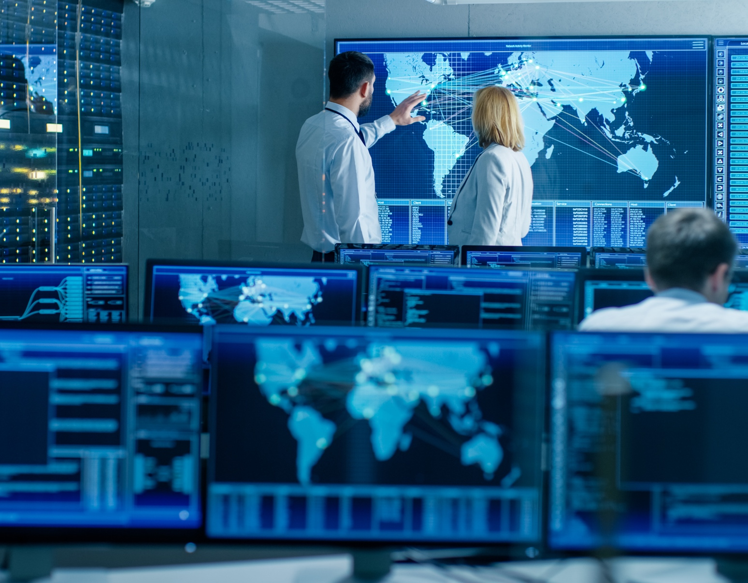
DM: The one platform that answers every communication need
    Training
    Medical diagnostics
    E-Gaming
    Surveillance
    Emergency response

Slide 5
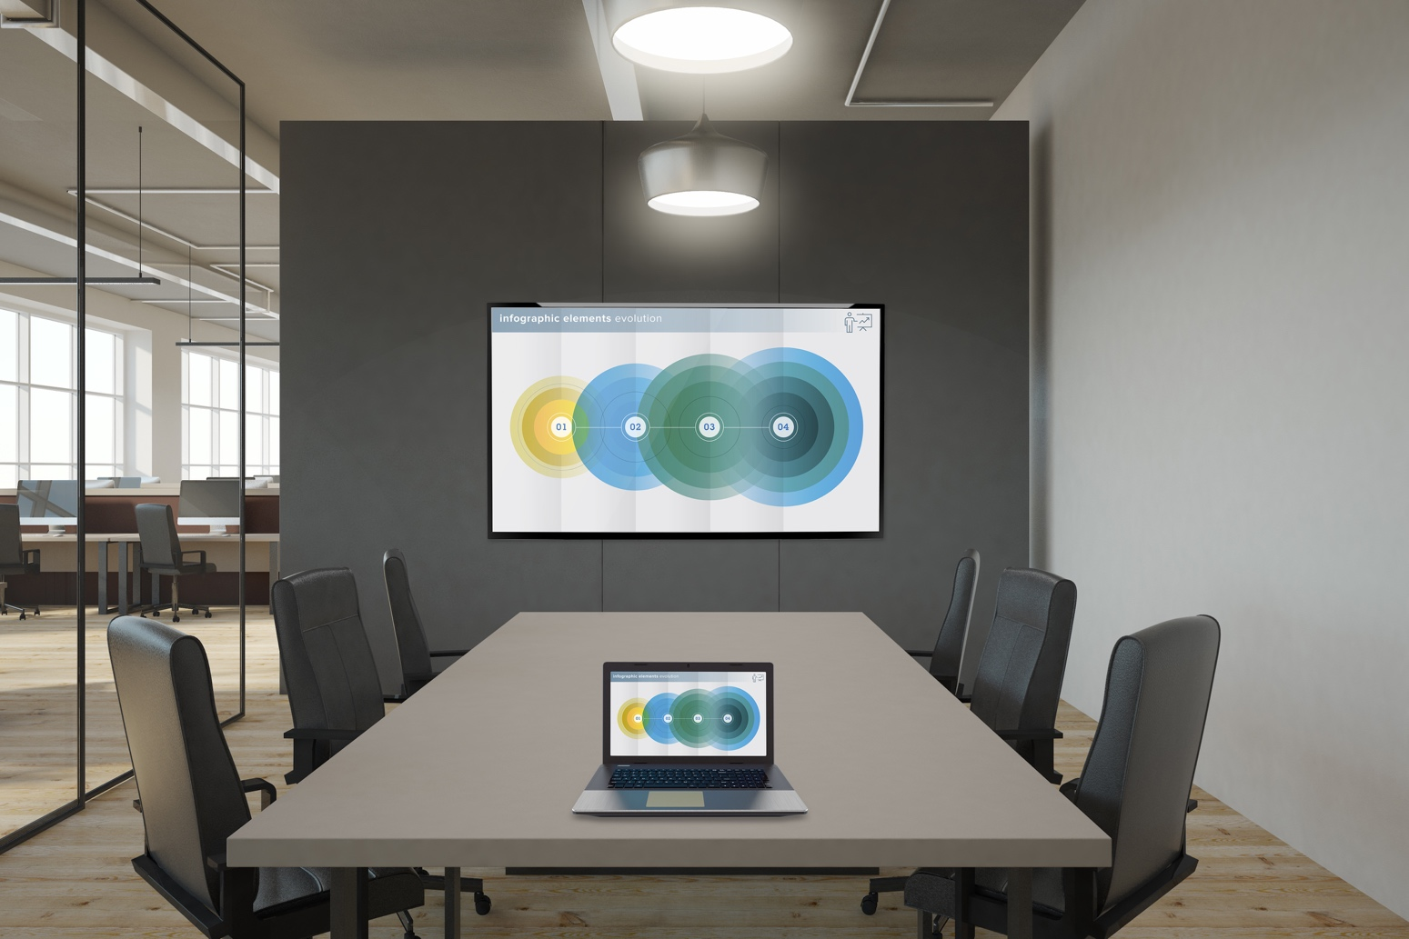
DM product family
The industry standard
  Widest range of connectivity options
  to distribute AV and control signals, from a single space, to an entire building or campus
    Meeting rooms
    Huddle spaces
    Public spaces
    Classrooms
    Lecture halls
    Boardrooms

Slide 6
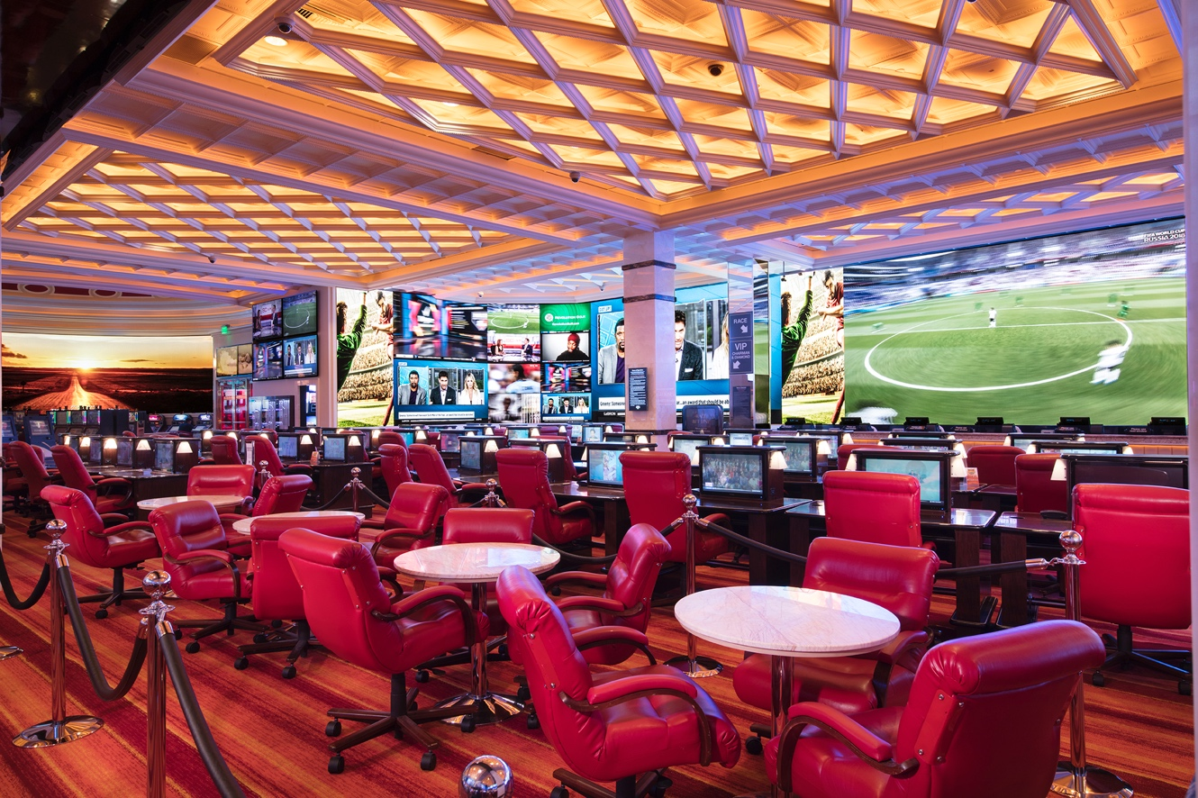
DM product family: The industry standard
    Auditoriums
    Arenas
    Command and control centers
    Bars and casinos
    Event spaces
    Hotel rooms
    Operating rooms
    Museums

Slide 7








Forging a stronger, more connected digital world, together

Slide 8
DM product family: Flexible
Supports all your connectivity needs
with a wide range of form factors
and infrastructures
  Seamlessly mix:
    4K60 HDBaseT®
    Single-mode and multimode fiber
    H.264 streaming AV
    4K60 AV-over-IP

Slide 9
DM product family
    Scalable: From simple point-to-point setup,
    to thousands of endpoints
    Reliable: Design, built, and guaranteed to work flawlessly as a complete system
    Secure: Leverages the most robust enterprise-grade network security standards
    Managed: Remotely configure, deploy, and manage large-scale networks

Slide 10
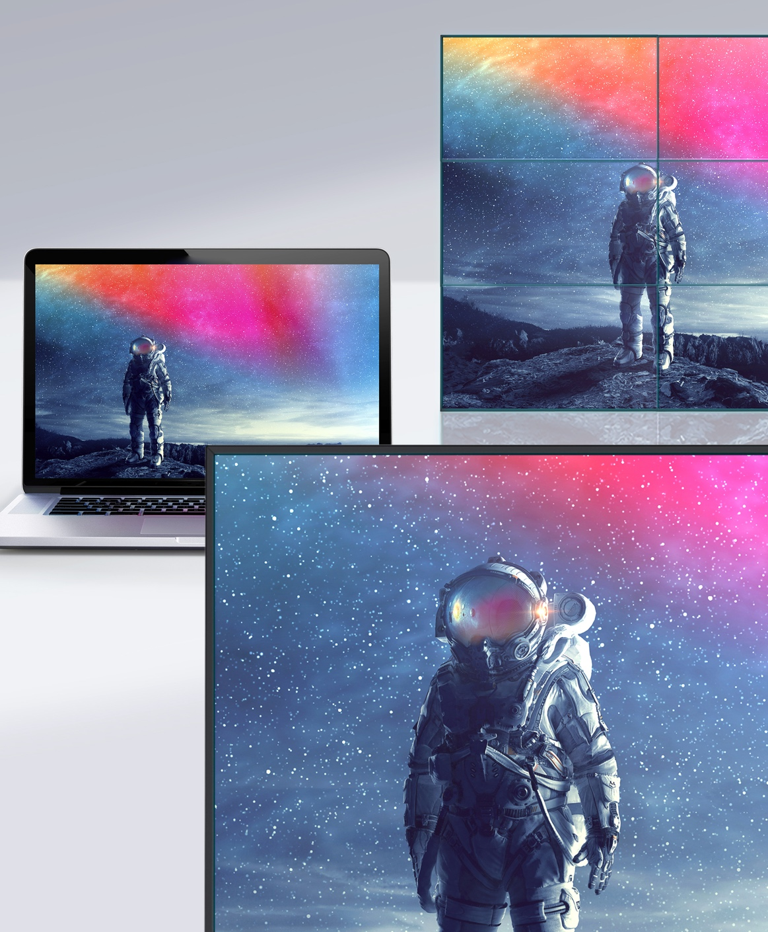
Distribution solutions for every space
DM Lite™ and DMPS Lite™
Simple room solutions
DMPS
All-in-one room solutions
DM Matrix
Scalable, configurable room solutions
DM NVX®
AV-over-IP solutions

Slide 11
Standalone Room Systems

Slide 12
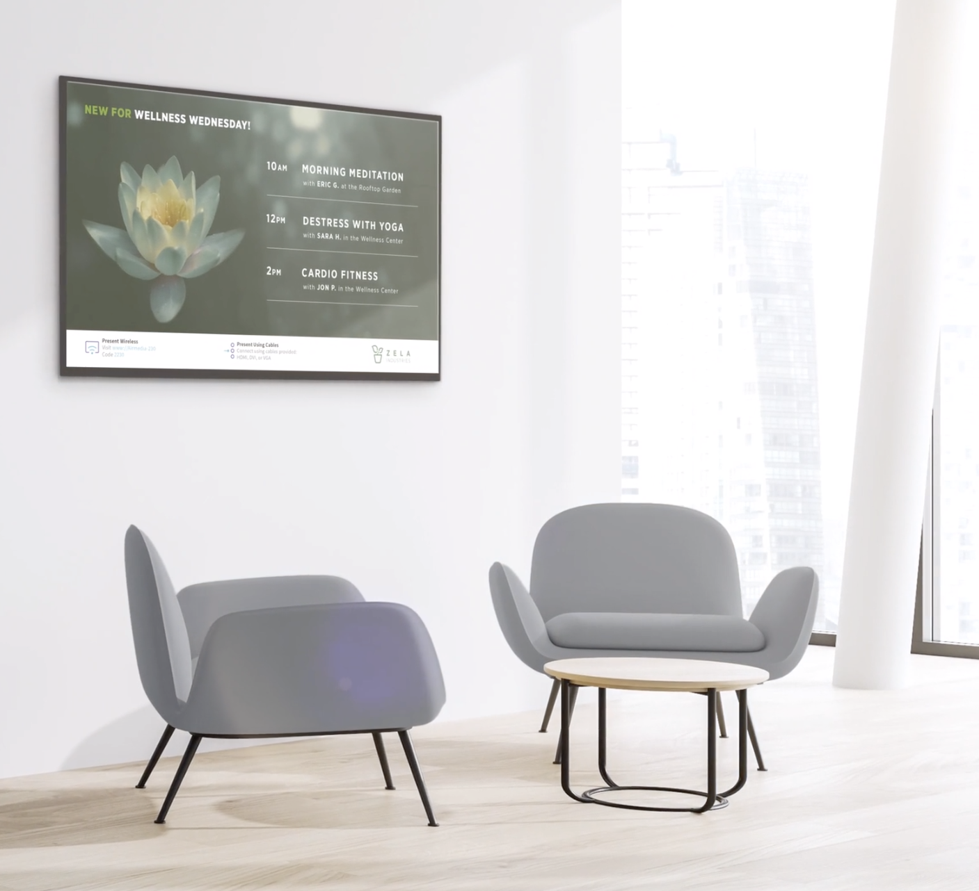
DM Lite and DMPS Lite
Perfect for smaller rooms
    High value / low cost
    High performance
Source-to-display (DM Lite) and multisource-to-display (DMPS Lite) solutions

Slide 13
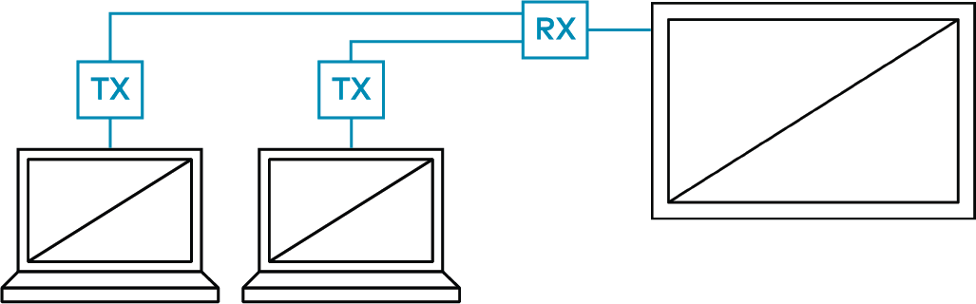
DM Lite: Key features
    Source-to-display
    Winning combination of low-cost
    yet high-performance
    Mix-and-match versatile transmitters and receivers
    Web-based configuration
    – no programming needed
    Pair based on form factor and the types of signals that need to be transmitted along with HDMI®

Slide 14
DMPS Lite: Key features
    Multisource-to-display
    High-value all-in-one AV solution
    for classrooms, huddle rooms,
    and small collaboration rooms
    Web-based configuration
    – no programming needed
    Ideal for spaces that require more than a DM Lite solution alone but less than all-in-one DMPS

Slide 15
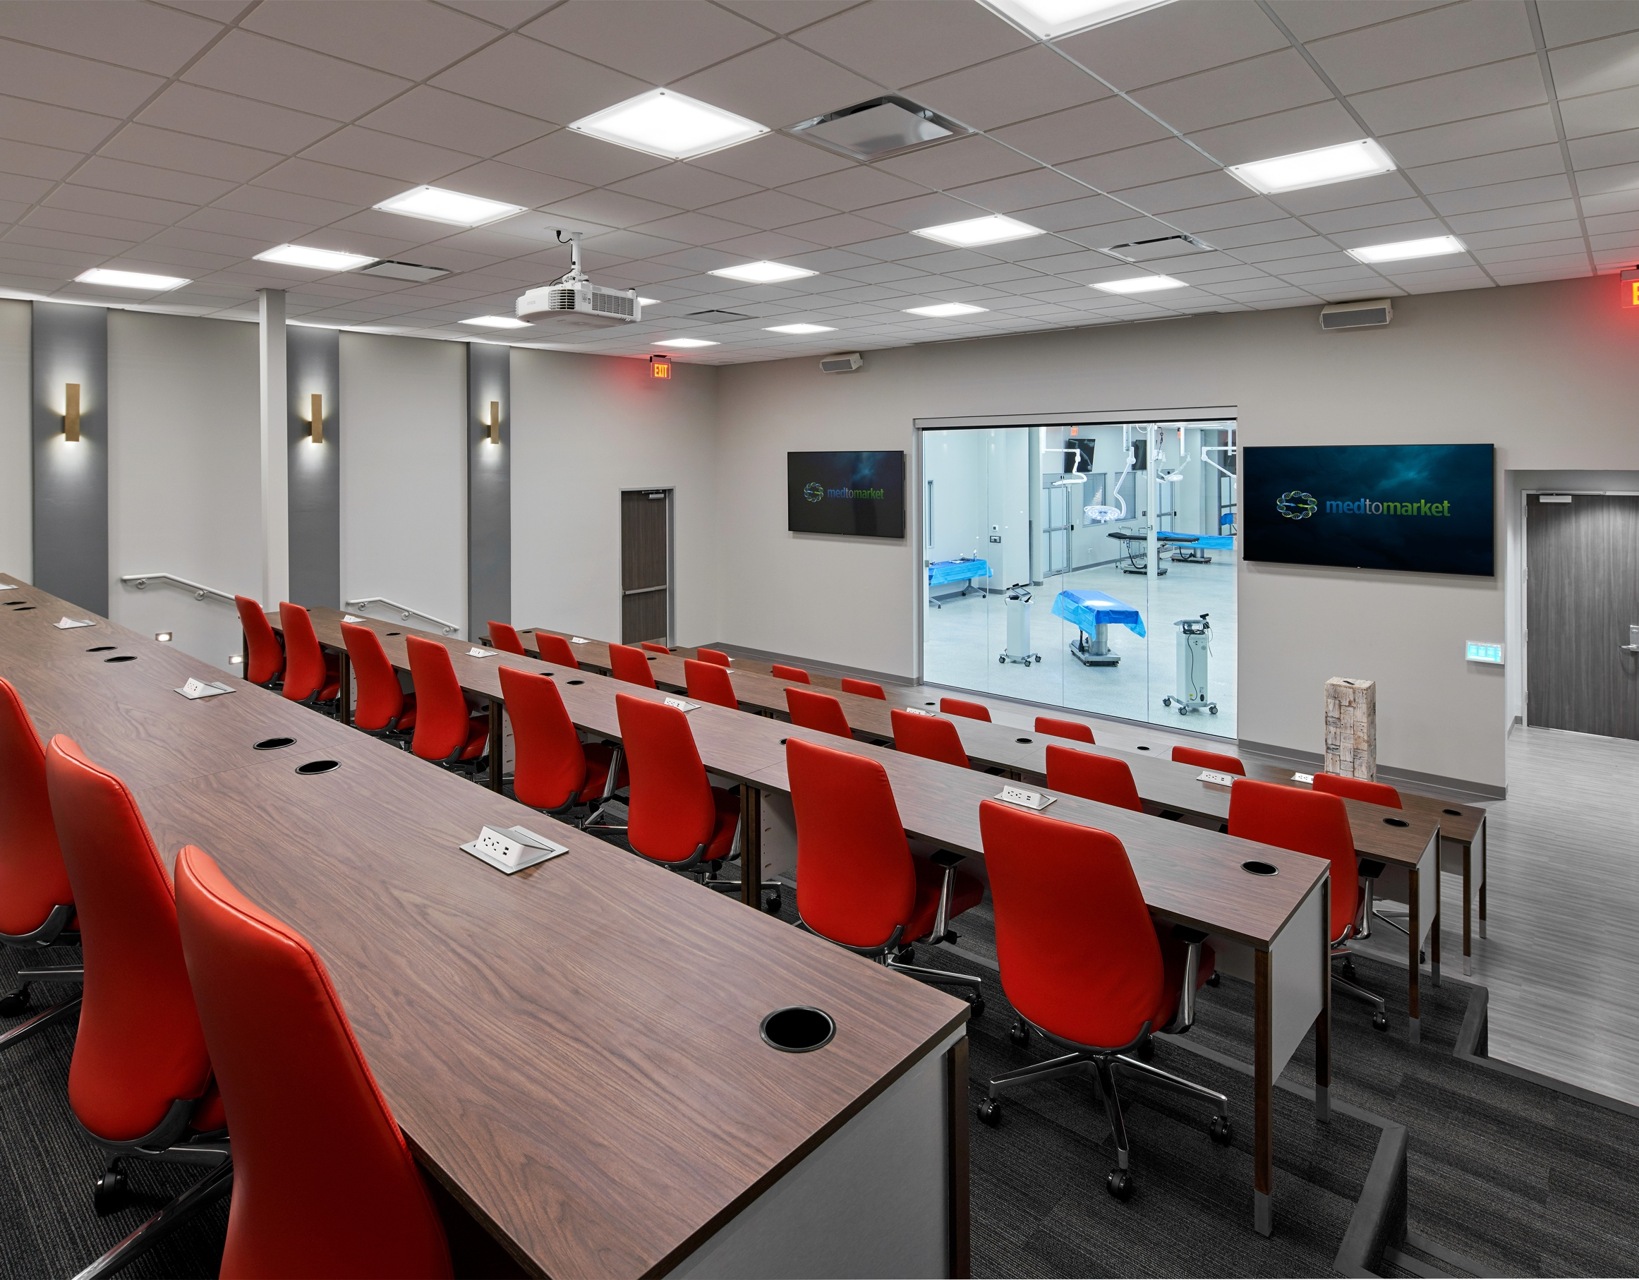
DM Lite/DMPS Lite: Success Stories
MedtoMarket
  DM provides this emerging medical think tank with the mission critical infrastructure their clients need to bring ideas to market.

Slide 16
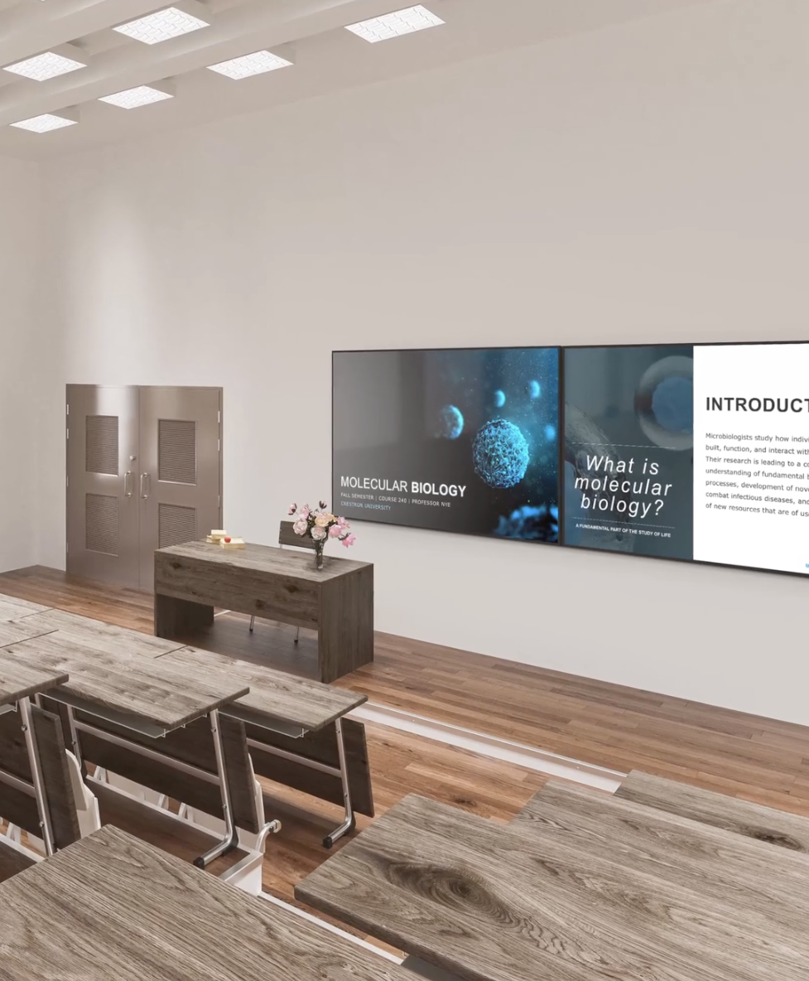
DMPS
All-in-one audio, video, room control, and wired/wireless presentation systems
Ideal for meeting rooms and classrooms
Feature built-in 3-Series® control system and 4K60 HDMI video with HDCP 2.2 to deliver unmatched power and performance

Slide 17
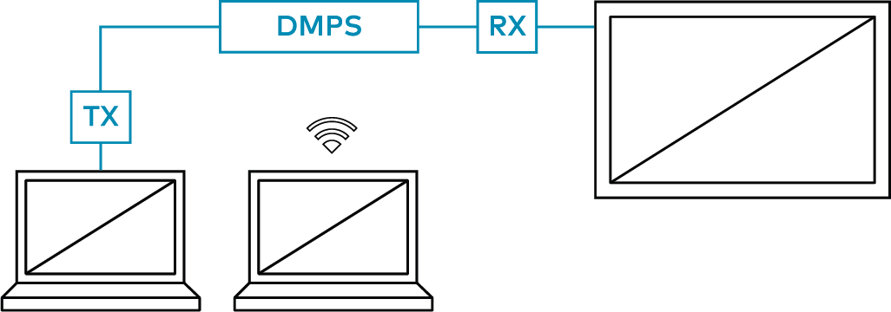
DMPS: Key features
    Control system
    4K60 multimedia switcher
    Audio switching/mixing
    4/8-Ohm or 70/100v amplification
    AirMedia® 2.0 wireless presentation
    Web-based configuration – no
    programming needed

Slide 18
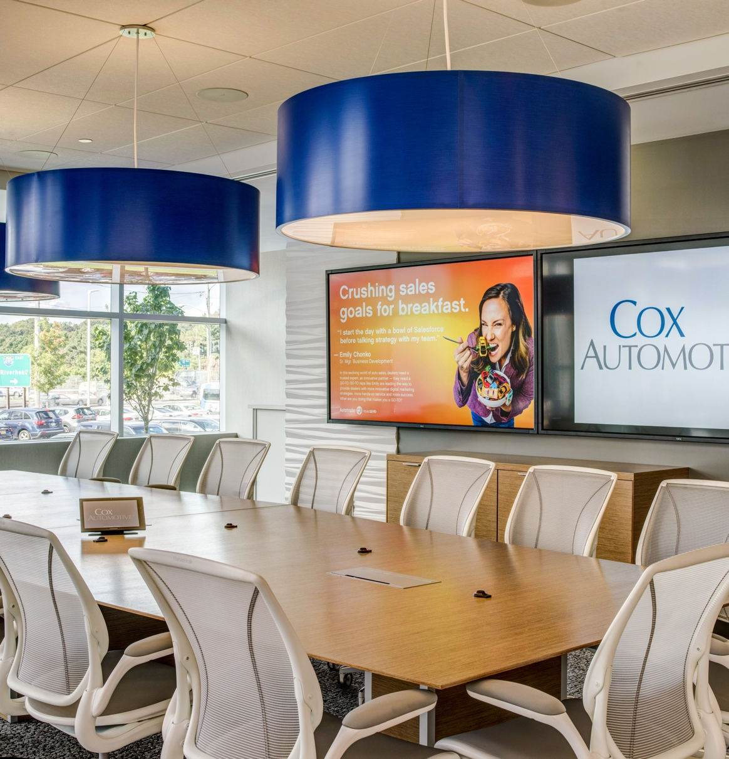
DMPS: Customer Success Stories
The Kleingers Group
DM helps Kleingers Group improves people’s lives through the design of new infrastructures.
Georgia Southern University
DM meets “The Three S’s” requirement at Georgia Southern University: Service, Simplicity, and Speed.
Dealertrack
DM has productivity and collaboration on the fast track at leading provider of digital solutions to the automotive retail industry.

Slide 19
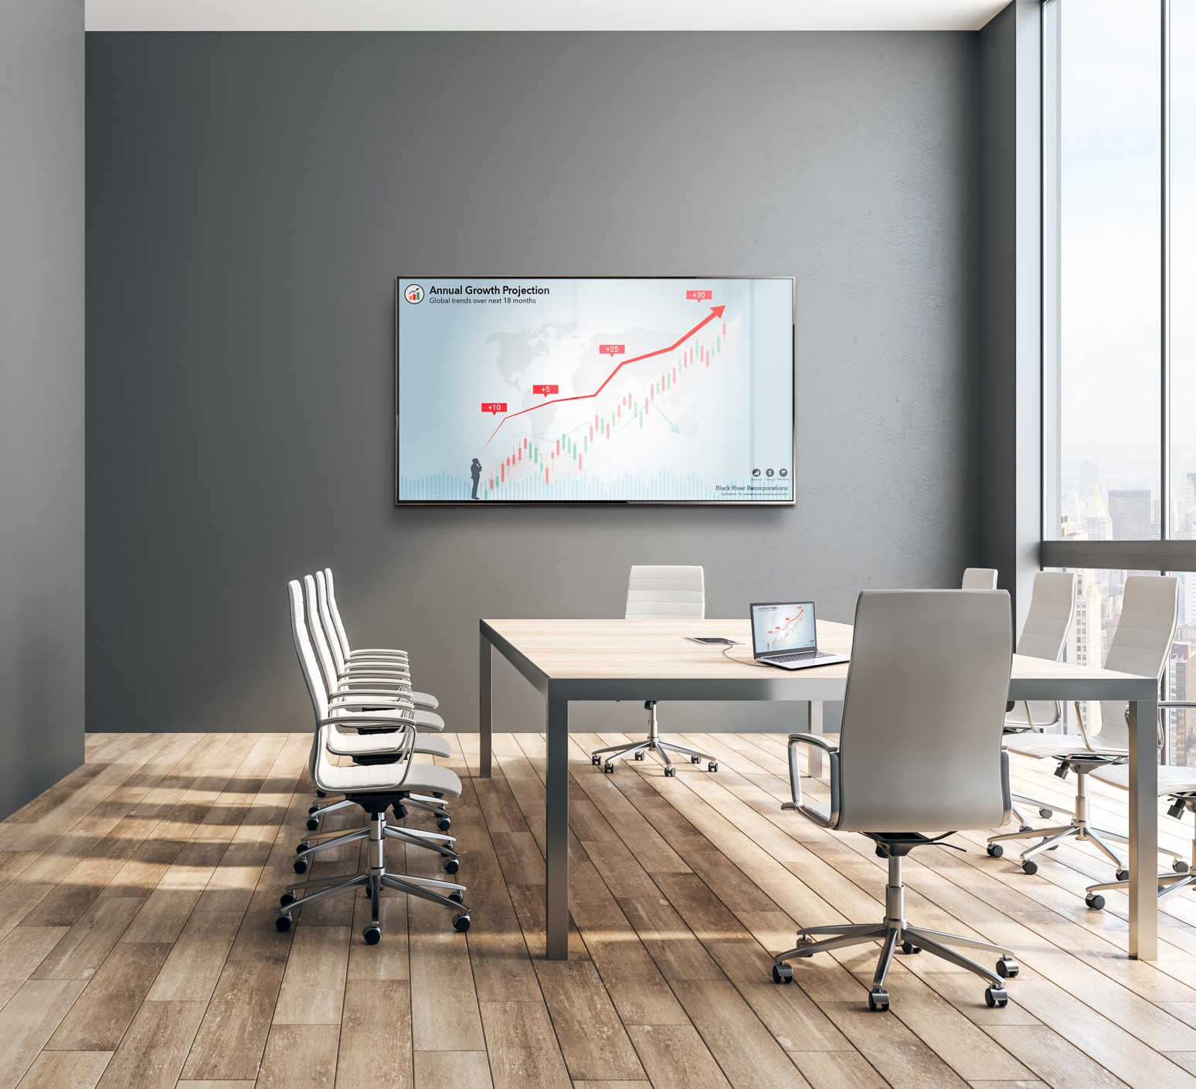
DM Matrix
Modular, expandable audio
and video switching
Configurable to accommodate any combination of digital sources, including 4K60 4:4:4 HDR, and analog
Only solution that offers ability to integrate copper, fiber, and streaming on single chassis

Slide 20
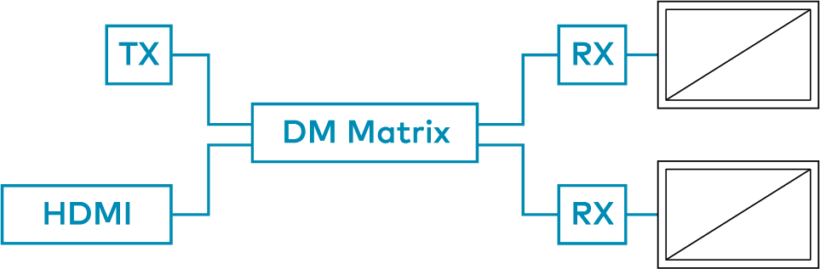
DM Matrix: Key features
    Scalable and modular
    Choose your frame
    Choose your input cards
    Choose your output cards
    Choose your endpoints
    Upgrade and evolve as needed

Slide 21
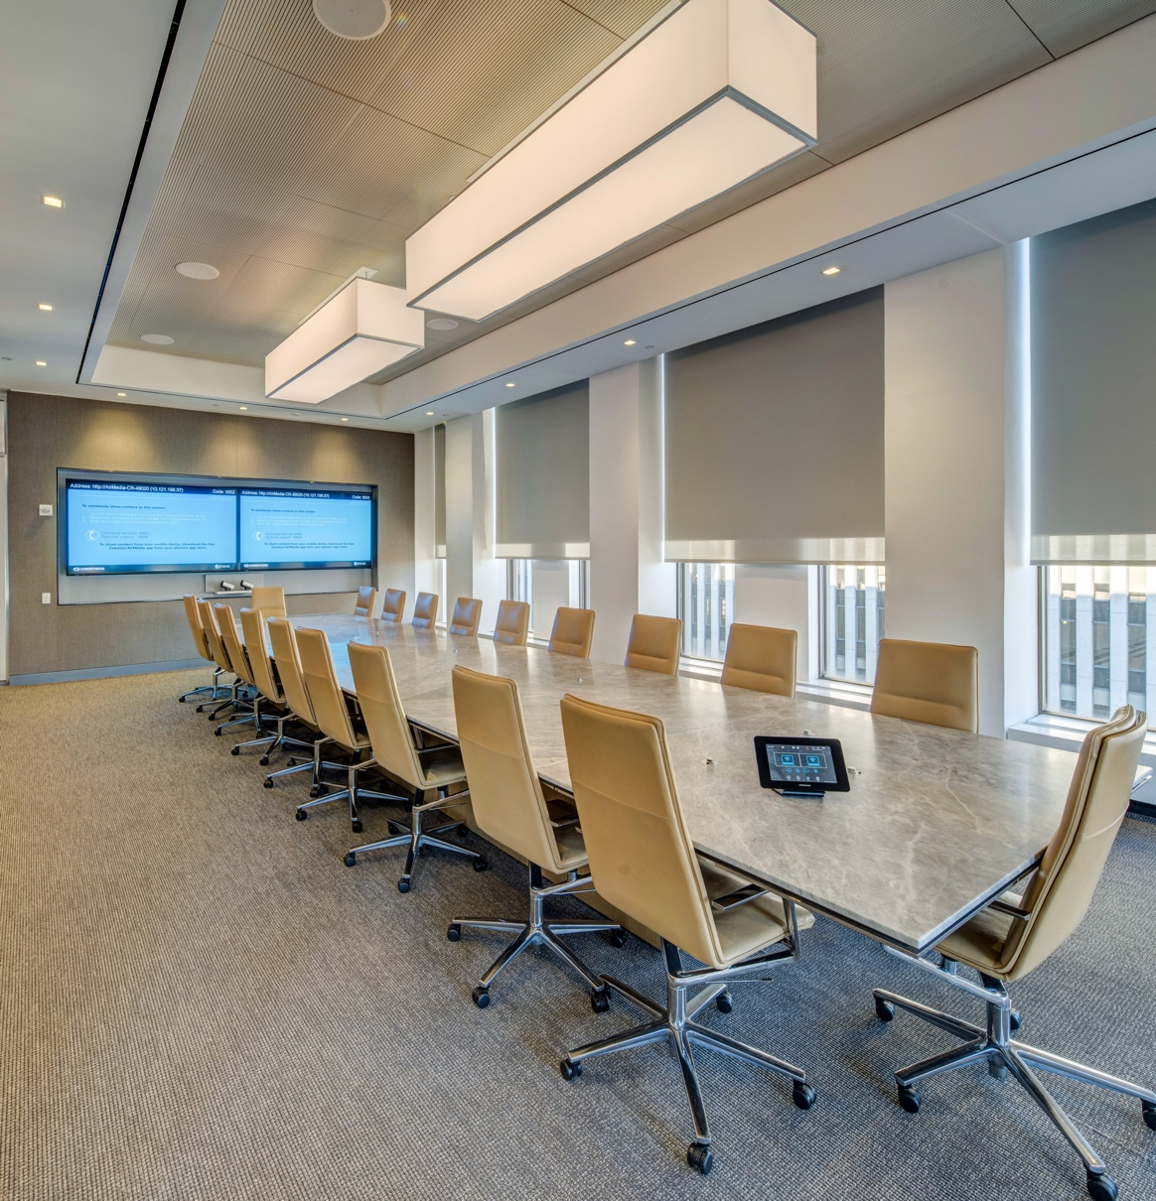
DM Matrix: Success Stories
Shopify
DM has helped Shopify create a workspace that not only helps employees be more productive, but also optimizes meeting space usage.
White & Case LLP
The verdict is in: DM makes meetings better at leading global law firm.
Los Angeles Memorial Coliseum
On gamedays, having reliable AV technology is everything. It’s why USC chose DM for its LA Coliseum upgrade project.

Slide 22
^{AV-over-IP}

Slide 23
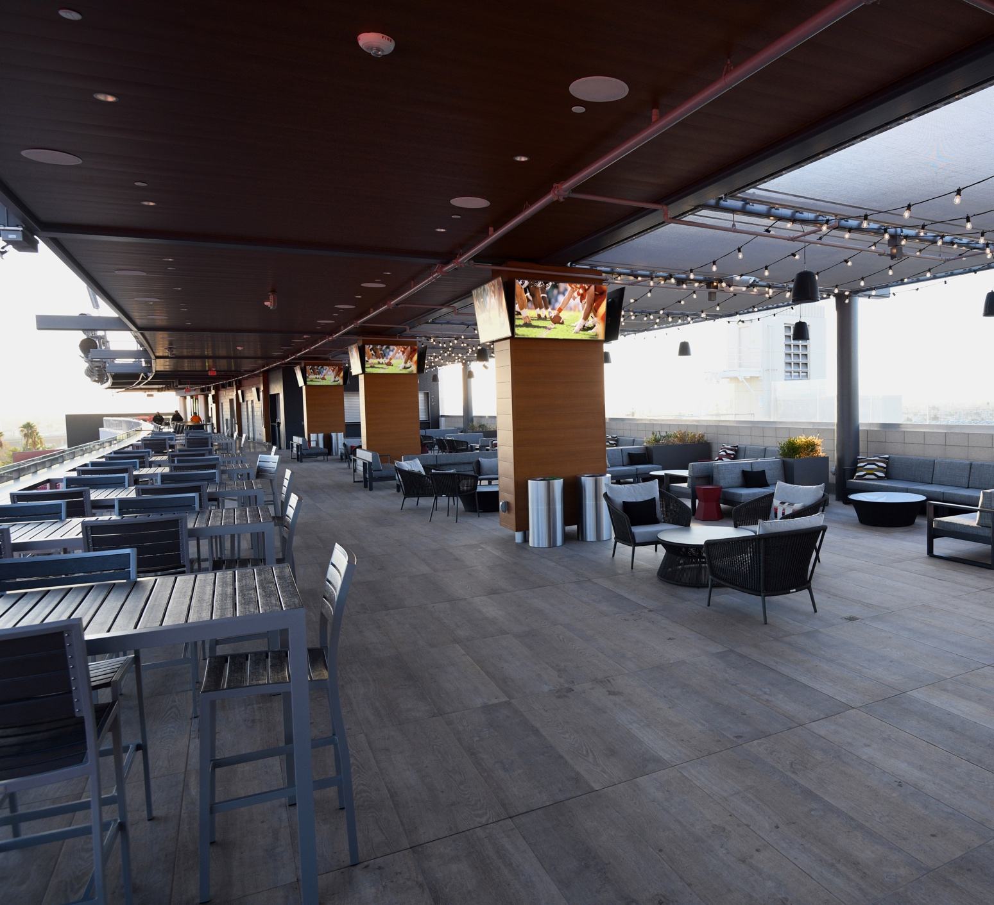
AV-over-IP
What to look for:
    Asymmetrically scalable – few inputs-to-many-outputs and vice versa
    Leverages existing 1Gb infrastructure and latest network security protocols
    Video quality the same as the source
    Supports ALL video sources you might encounter, including 4K60 4:4:4, HDR10, HDR10+ and Dolby Vision®

Slide 24
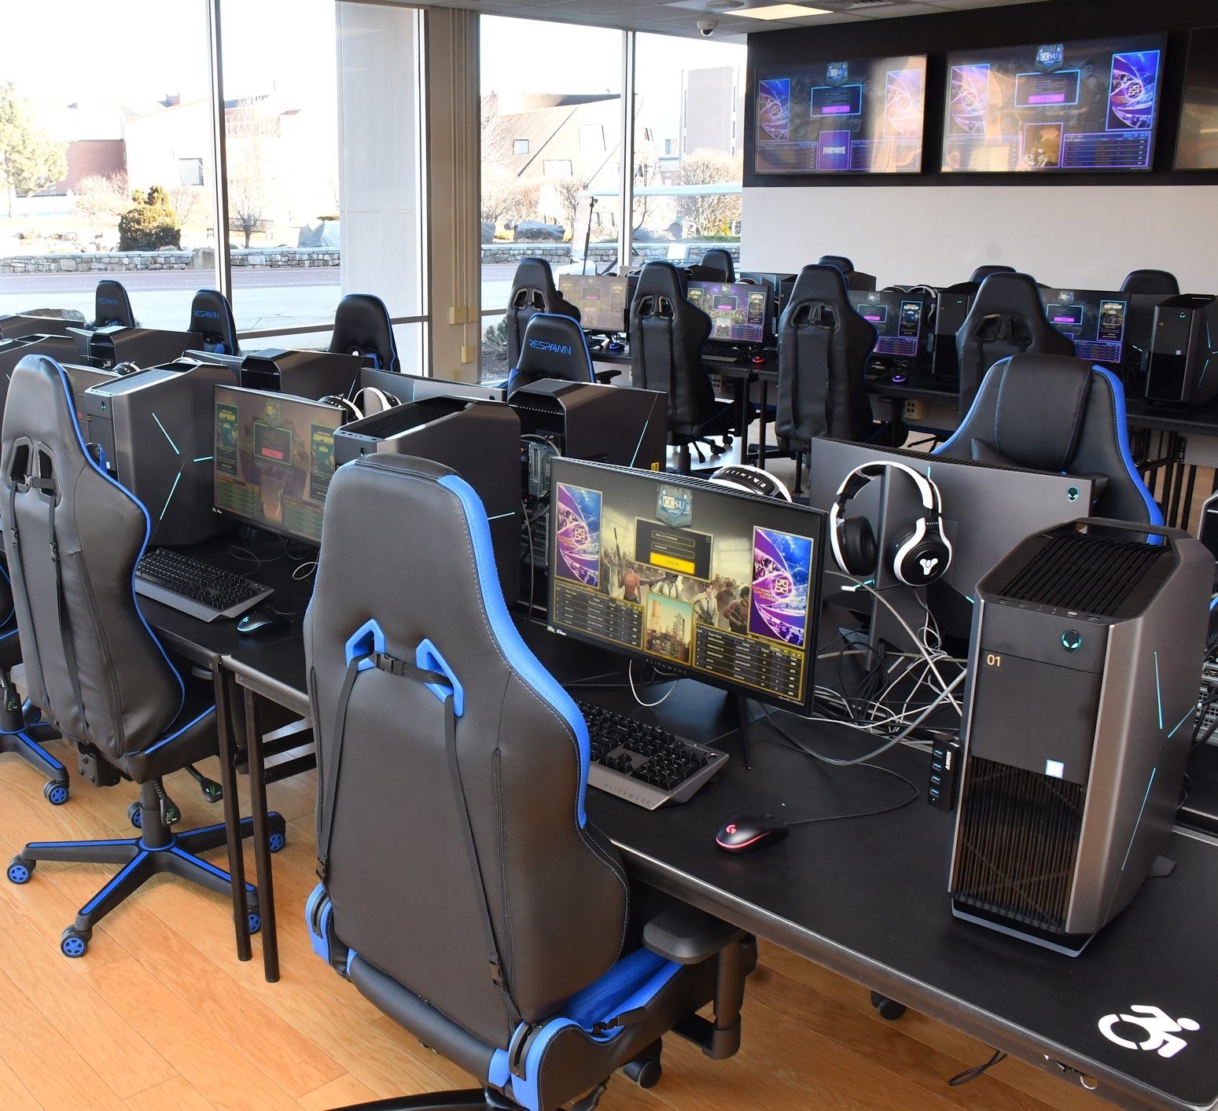
AV-over-IP
What to look for:
    Zero perceivable latency
    Supports AES67 and Dante®
    audio networking
    Supports USB 2.0 and HID
    Proven track record in the field

Slide 25
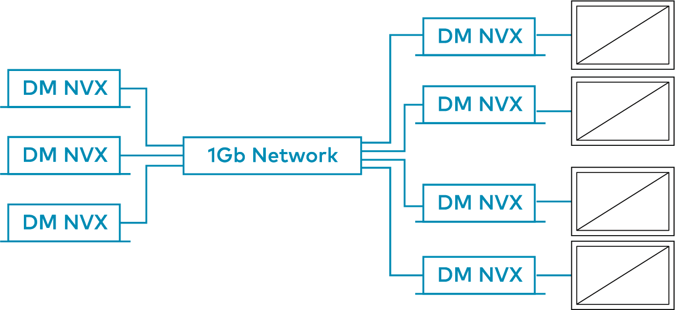
DM NVX AV-over-IP
    Complete, secure, scalable,
    and managed 1Gb AV-over-IP solution
    Delivers image quality as
    good as the source
    Deploy, manage, monitor, and evolve at scale via the IoT-based Crestron XiO Cloud® platform
    Renowned Crestron reliability

Slide 26









The standards you use. The interoperability you want.
DM NVX works with industry standards and systems you have, so you can achieve whatever you want.
Standards
Extend DM NVX…
Broad range of video and audio standards.
Into the world of the most popular displays with a plug-and-play solution: DM-NVX-D80 IoAV decoder
With existing DigitalMedia™ and HDBaseT® systems with the DM-NVX-E760

Slide 27
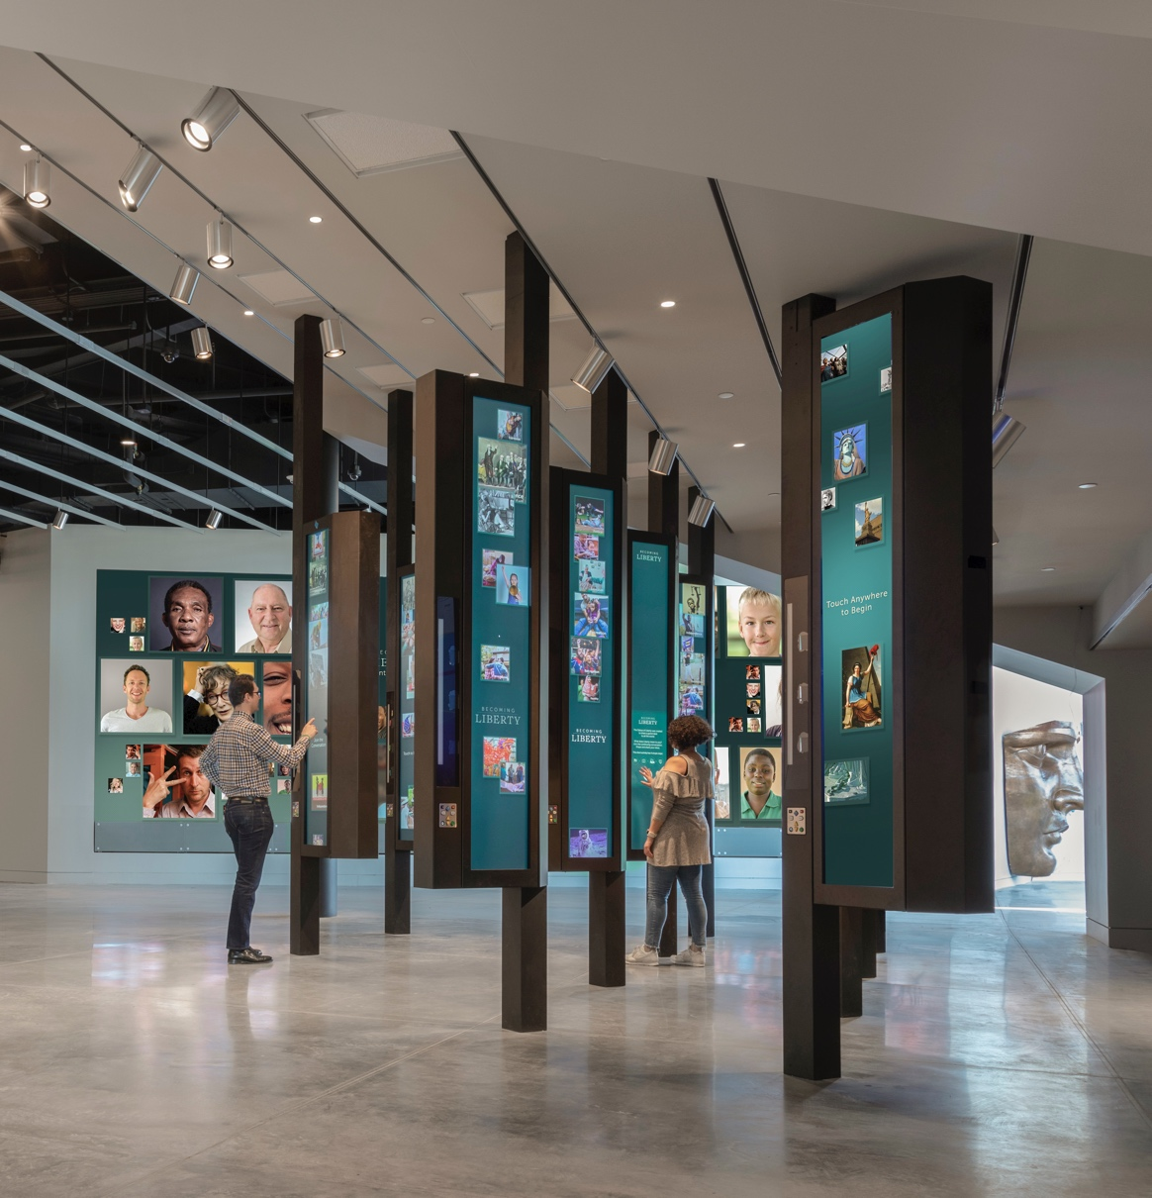
DM NVX: Success Stories/Testimonials
Peppermill® Resort Spa Casino
From the guest rooms to the casino, DM NVX technology ensures that this show stopping casino resort is truly one to remember.
The University of Notre Dame
DM NVX technology has transformed learning at the school known for the “Golden Dome.”
Statue of Liberty Museum
DM NVX technology helps deliver content in a way that enhances the experience of thousands of daily visitors.

Slide 28
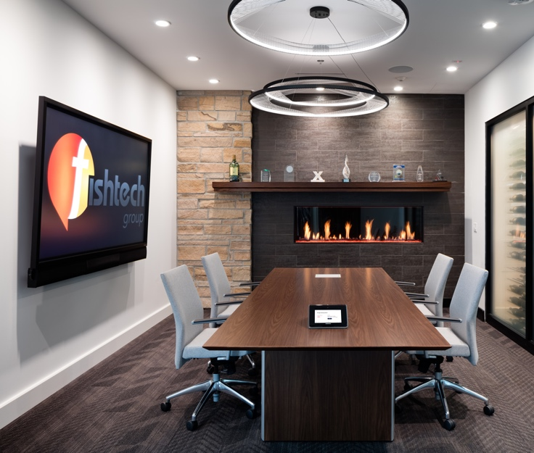
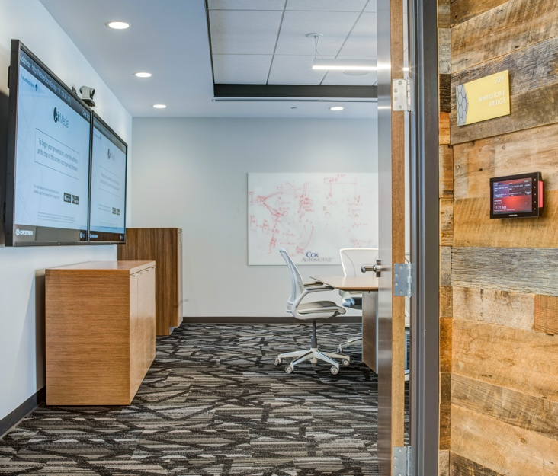
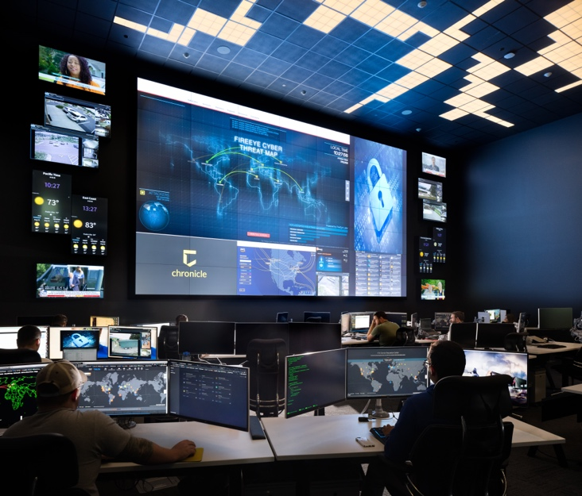
There’s a DM solution for every need
From control and
display in-room…
to a complete all-in-one
room system…
to a scalable AV-over-IP network
with centralized management

Slide 29

HDMI accessories
Everything you need to integrate 4K HDMI sources with a DM system
    Cables
    HDMI switchers
    Distribution amplifiers
    Scalers
    USB extenders

Slide 30
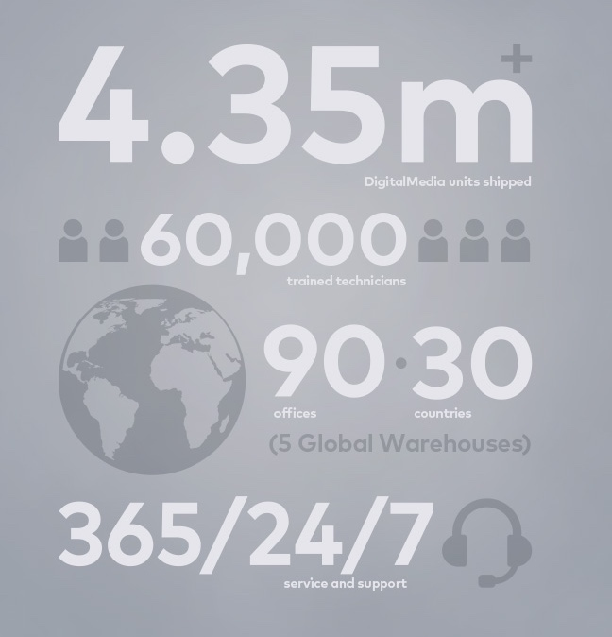
DM by the numbers
4.35M units shipped
    Time tested, field proven
60k trained technicians
    The largest global community of certified
    AV professionals
24/7/365 service and support
    Award-winning elite group of dedicated
    on-call professionals
90 offices in 30 countries
    Local sales and support across the globe
5 global distribution centers
    The products you need, whenever and
    wherever you need them

Slide 31
Learn more at crestron.com/DM

