Slide 1
DMPS Lite and DM Lite
Simple Room Solutions

Slide 2


Slide 3
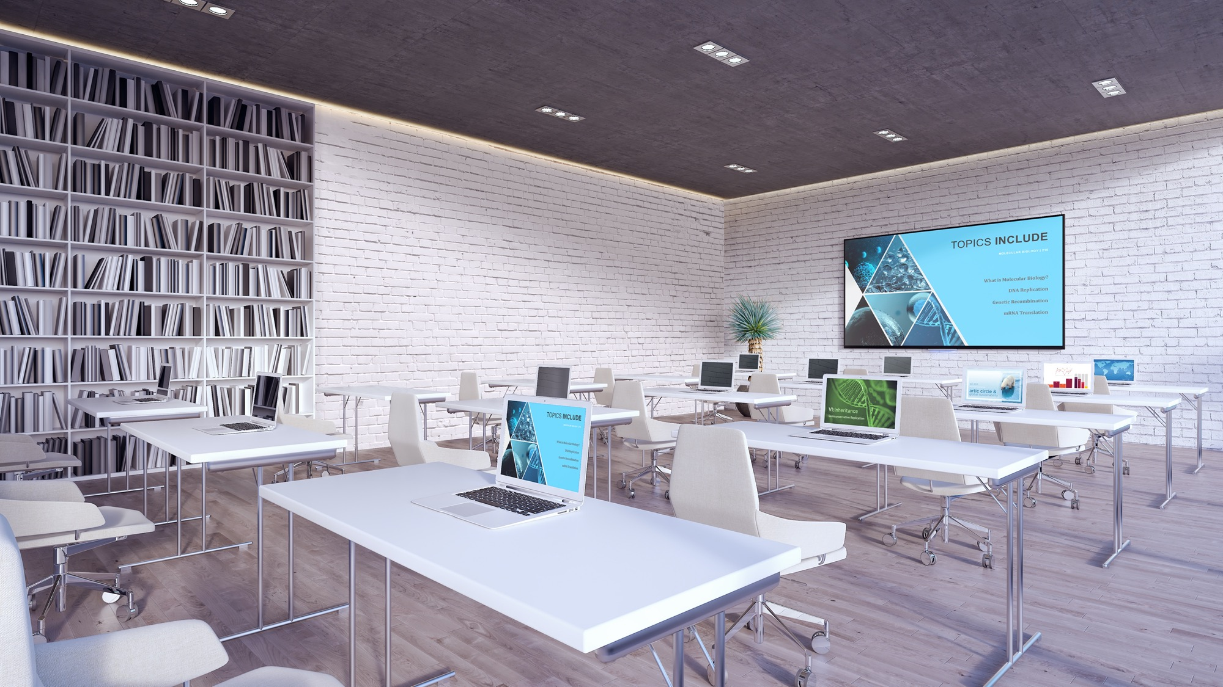

Plug-and-play DMPS Lite™ and DM Lite® solutions cover all the bases in smaller spaces.
Cost-effective. Flexible.
No programming needed.

Slide 4
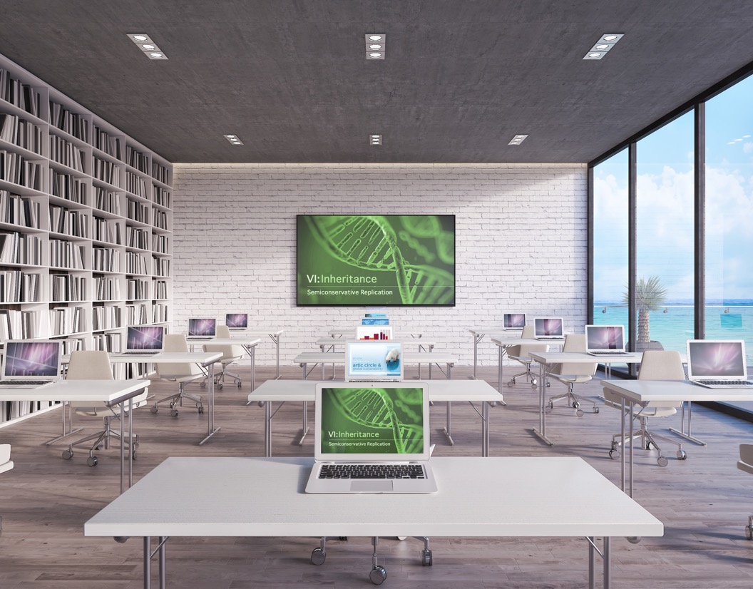
DMPS Lite: Multisource-to-Display
    DMPS Lite products give you a high-value all-in-one AV solution for classrooms, huddle rooms, and small collaboration rooms.
    DMPS Lite expands your reach into spaces that require more than a DM Lite source-to-display solution alone, but less than an all-in-one DMPS3 Series system.

Slide 5
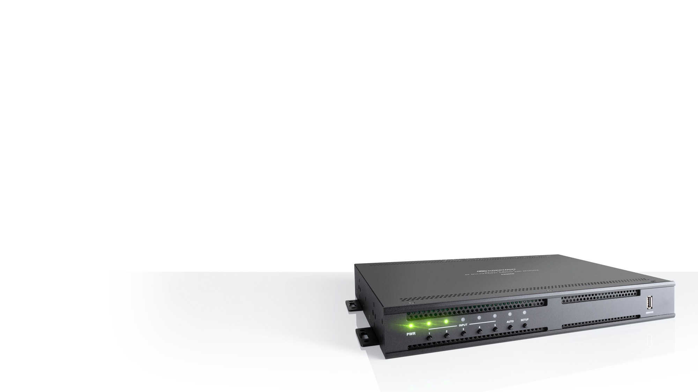
DMPS Lite: Multisource-to-Display
Benefits
    Standalone web configuration with auto-routing and display control
    Ability to upgrade and monitor via Crestron XiO Cloud® service
    Easily upgrade, service, and evolve technology within smaller spaces
    Improved network connectivity for high-traffic networks
Features
    4K video scaler
    Audio amplification (410 and 510 models)
    Upgrade, Monitor and evolve with XiO Cloud

Slide 6
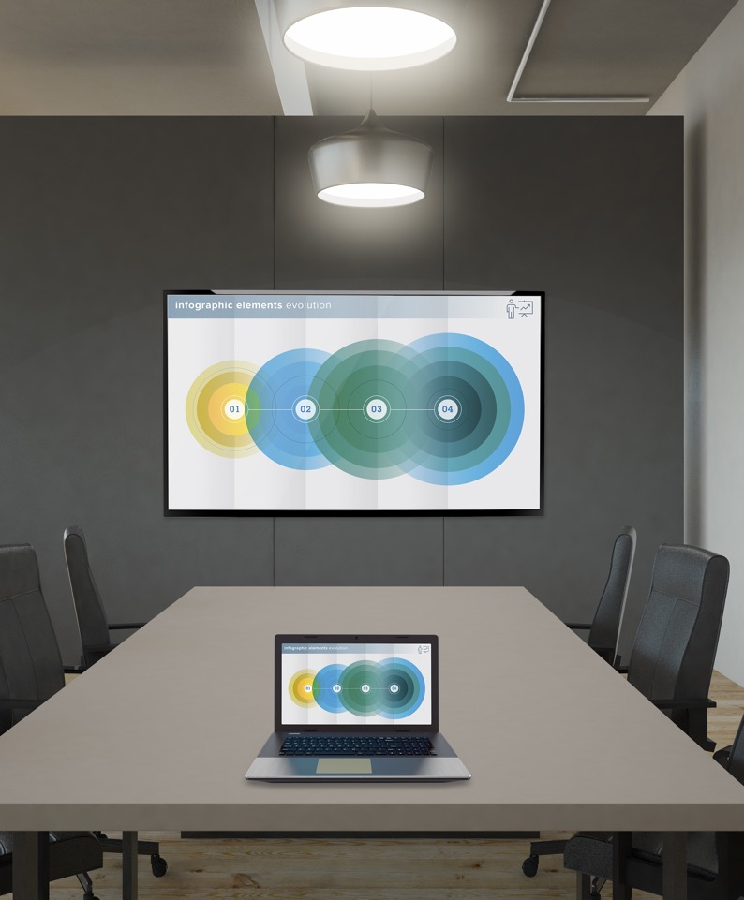
DM Lite: Source-to-Display
    Mix-and-match versatile DM Lite transmitters and receivers to create simple systems for most spaces. DM Lite delivers a winning combination of low-cost, yet high-performance.
    Pair them based on form factor and the type of signals that need to be transmitted along with HDMI® connectivity.

Slide 7
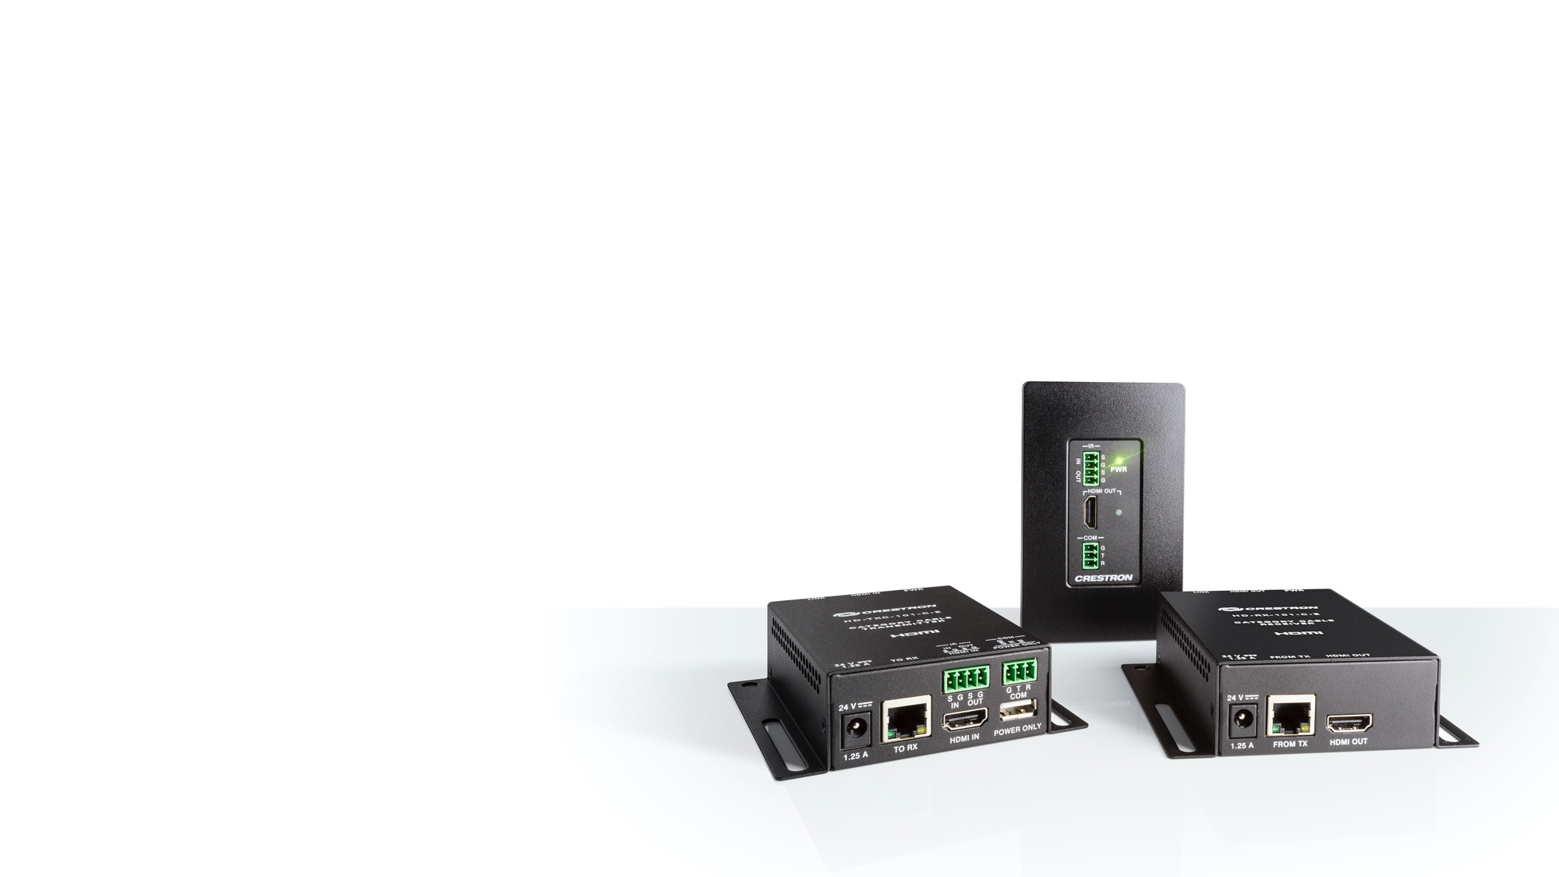
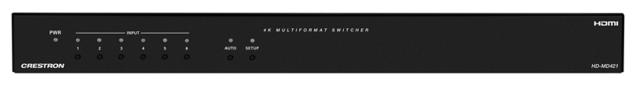
DM Lite: Source-to-Display
Benefit
    Mix-and-match DM Lite transmitters and receivers to support the signal extension you need
      Audio
      Video
    Interoperable with DMPS Lite products
    Switchers with DM Lite input and output
Features
    Switching and transport of 4K
    and control signals over
    standard CAT5e (select models)

Slide 8
DMPS Lite and DM Lite
Product Lineup

Slide 9
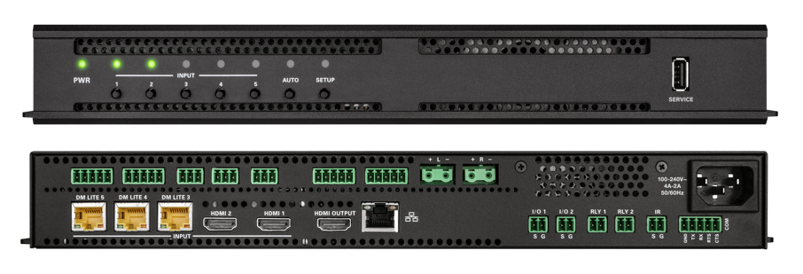
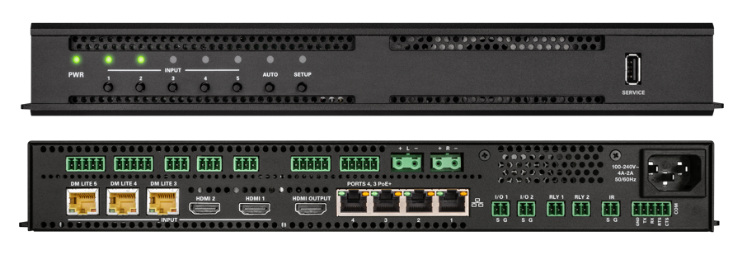
DMPS Lite: Products
HD-RX-4K-510-C-E
HD-RX-4K-510-C-E-SW4
  4K Multiformat 5x1 AV Switcher and Receiver
  4K Multiformat 5x1 AV Switcher and Receiver with 4-Port Ethernet Switch

Slide 10
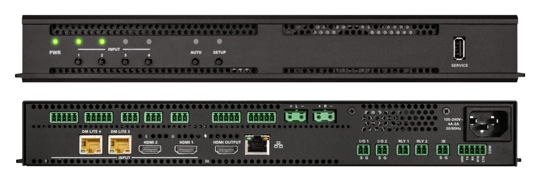
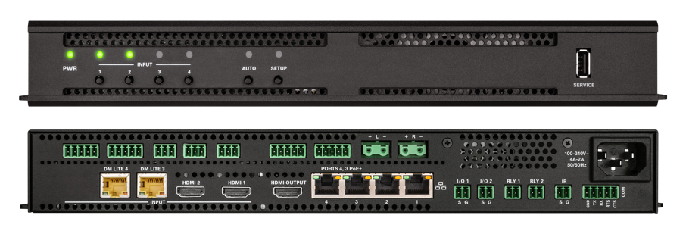
DMPS Lite: Products
HD-RX-4K-410-C-E
HD-RX-4K-410-C-E-SW4
4K Multiformat 4x1 AV Switcher and Receiver
4K Multiformat 4x1 AV Switcher and Receiver with 4-Port Ethernet Switch
Notes:
Sarah – 510 the 410 also has Audio amplification so you can add speakers without needed an amp. Rack or wallmountable
Daniel - Example

Slide 11
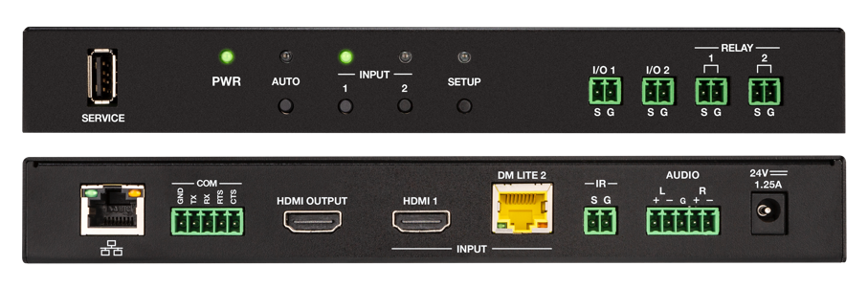

DMPS Lite: Products
HD-RX-4K-210-C-E
HD-RX-4K-210-C-E-PoE
4K Multiformat 2x1 AV Switcher and Receiver
4K Multiformat 2x1 AV Switcher and Receiver w/PoE

Slide 12
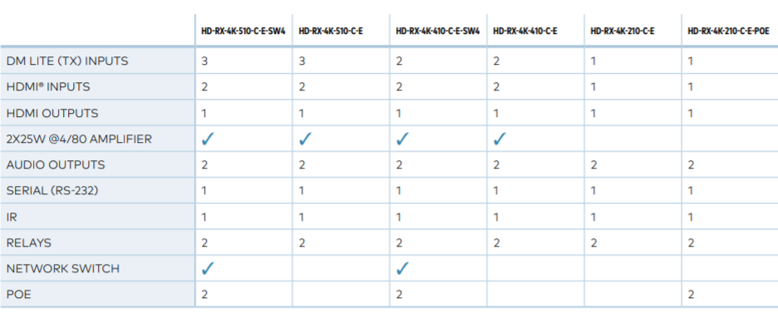
DMPS Lite: Products

Slide 13
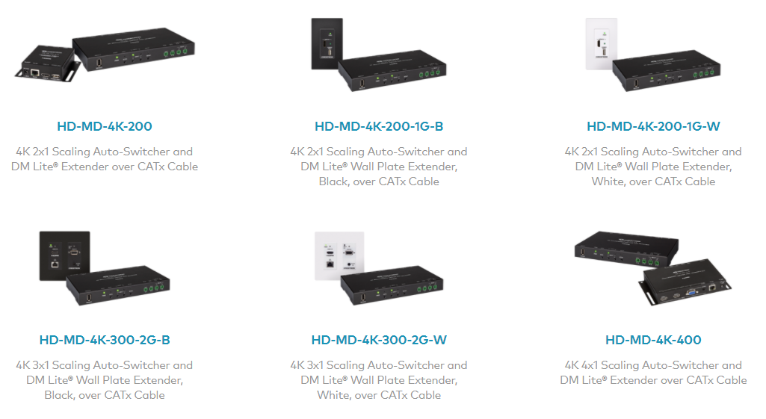
DMPS Lite: Products
210 Kits: More options
    Paired with our most popular DM Lite transmitters
    2x1, 3x1, or 4x1 switching solutions
    Includes everything you need to create simple, yet powerful AV spaces

Slide 14
DM Lite: Products
Transmitters
Receivers
    HD-TX-101-C-E
      HDMI over CATx Transmitter, Surface Mount
    HD-TXC-101-C-E
      HDMI over CATx Transmitter w/IR & RS-232, Surface Mount
    HD-TX-101-C-1G-E
      HDMI over CATx Transmitter, Wall Plate
    HD-TXC-101-C-1G-E
      HDMI over CATx Transmitter w/IR & RS-232, Wall Plate
    HD-TX-201-C-2G-E
      HDMI over CATx Transmitter & 2x1 Auto-Switcher
      w/VGA & Analog Audio, Wall Plate
    HD-TX-301-C-E
      HDMI over CATx Transmitter & 3x1 Auto-Switcher
      w/2x HDMI plus VGA & Analog Audio, Surface Mount
    HD-RX-101-C-E
      HDMI over CATx Receiver, Surface Mount
    HD-RXC-101-C-E
      HDMI over CATx Receiver w/IR & RS-232, Surface Mount
    HD-RX-101-C-1G-E-B-T
      HDMI over CATx Receiver, Wall Plate
    HD-RXC-101-C-1G-E-B-T
      HDMI over CATx Receiver w/IR & RS-232, Wall Plate
    HD-RX-201-C-E
      HDMI over CATx Receiver, Room Controller,
      2x1 Auto-Switcher, HD Scaler, Surface Mount

Slide 15
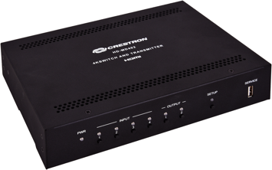
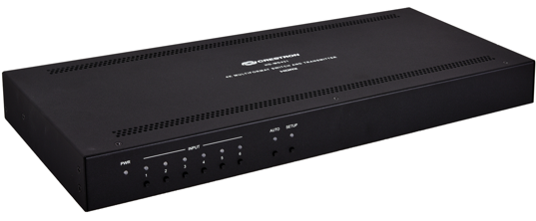


DM Lite: Products
Switchers
    Basic switching capabilities right out of the box
      Auto-routing
      Priority-routing
      Native display control
      Remote extension via DM Lite
Target applications ​
    Medium to large conference rooms,
    multi-purpose spaces
    Presentation classrooms – universities and K-12​
    Any application requiring fixed multi-source to single/dual-display distribution
HD-MD402 | HD-MD421
4x2 switcher with 4K to 1080p down-scaler 4 x HDMI inputs 1 x mirrored DM Lite/HDMI output 1 x DM Lite output 4K60 4:2:0; 4K to 1080p down-scaler Built-in input detection and display control Joining plate option for rack mounting next to Crestron AMP products RS-232 control | 6x1 switcher with 4K scaler 4 x HDMI inputs 2 x DM Lite inputs (single input transmitters only) 1 x mirrored DM Lite/HDMI output 4K60 4:2:0 with 4K scaler Microphone input, unbalanced audio inputs; Balanced audio output Built in auto-switching, priority routing, input detection and display control RS-232 control

Slide 16
Web-based configuration
How do you get a system up and running?

Slide 17
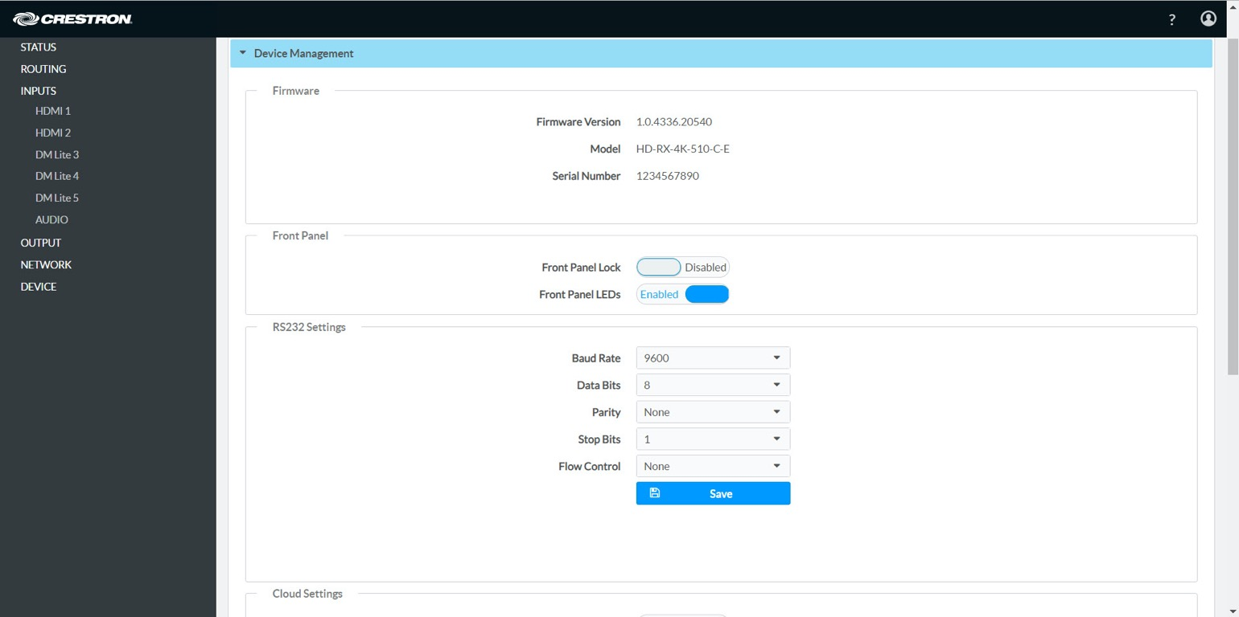
Native web-based configuration

Slide 18
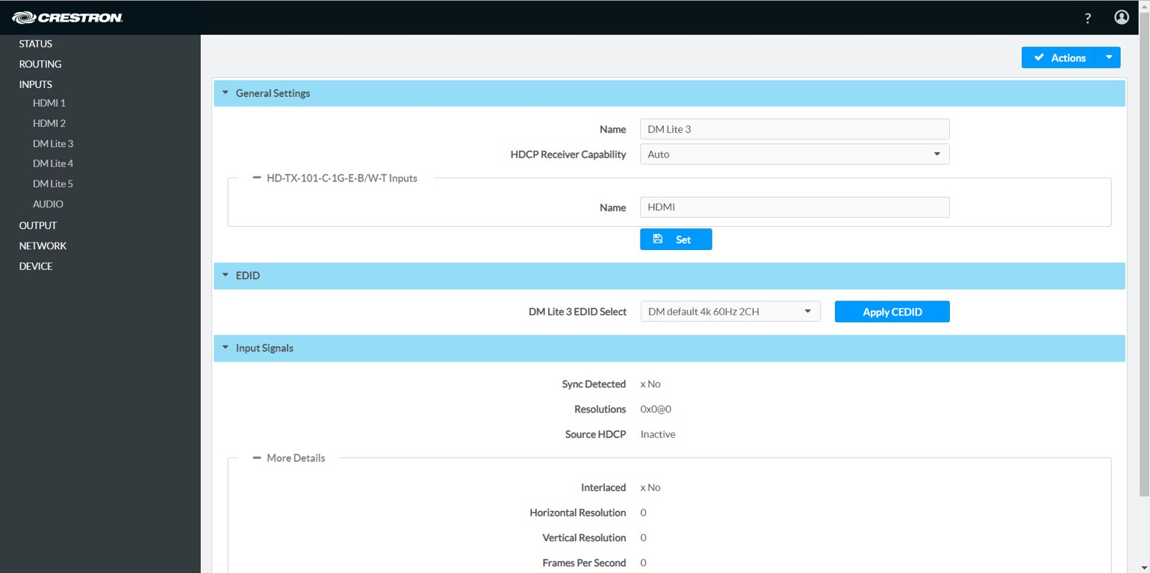
Native web-based configuration

Slide 19
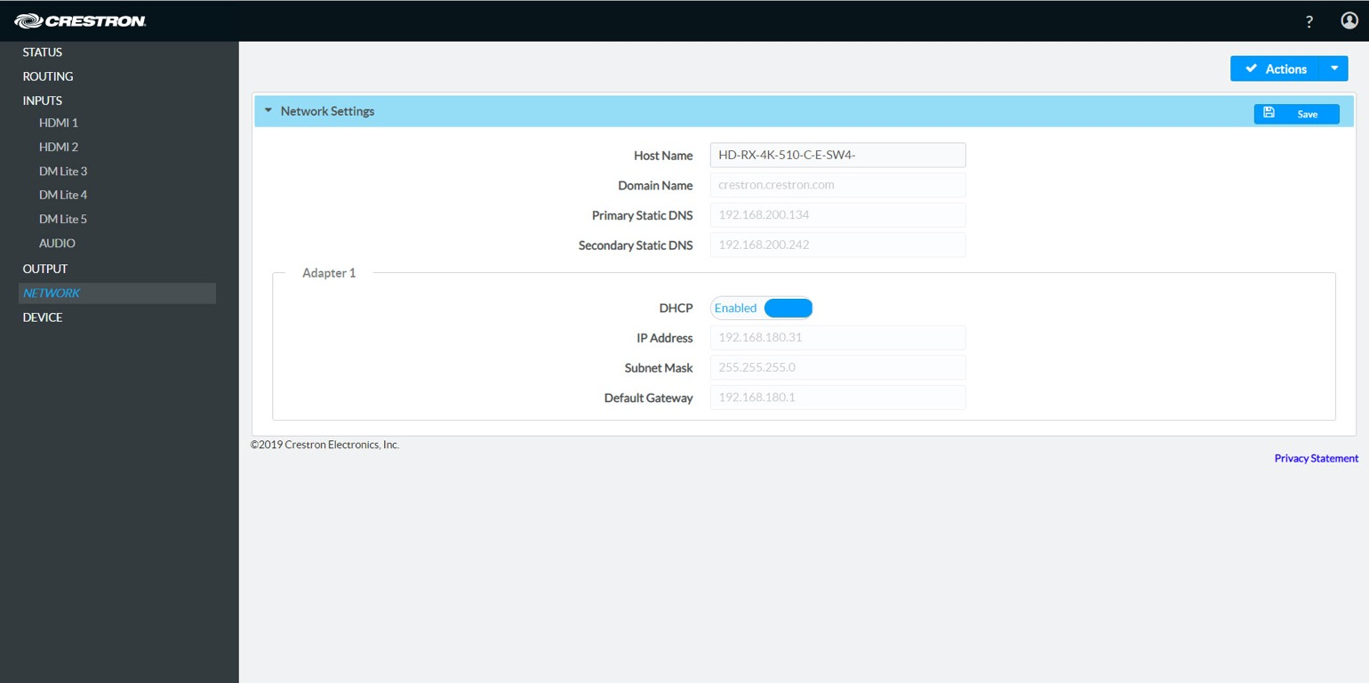
Native web-based configuration

Slide 20
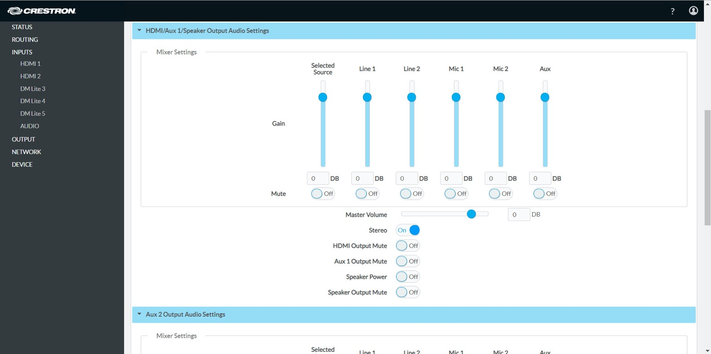
Native web-based configuration

Slide 21
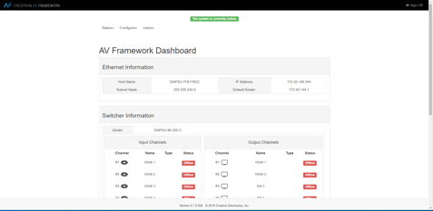
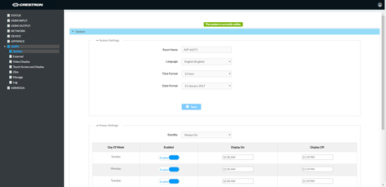


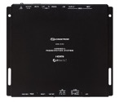
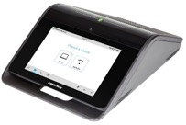

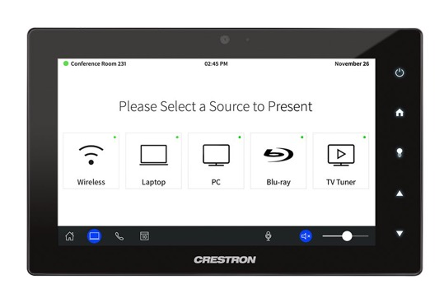

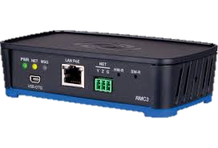
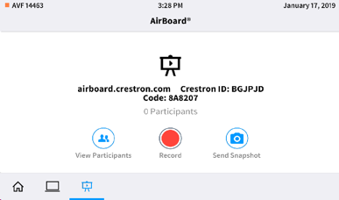
.AV Framework™ software – web-based configuration
1. Processor
2. Configuration UI
AVF Config On DMPS/VC-4/MPC3/RMC3
AVF Config On Mercury/AM
3. User-facing UI

Slide 22
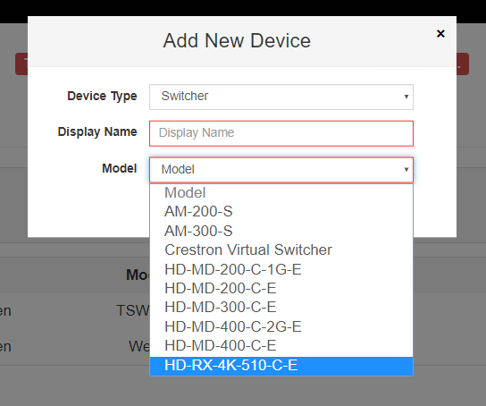
As simple as 1–2–3
Step 1 – Install
    Simply install .AV Framework on an MPC3 or RMC3, add the HD-RX-4K-510-C-E as a switcher.
1. Install the Hardware

Slide 23
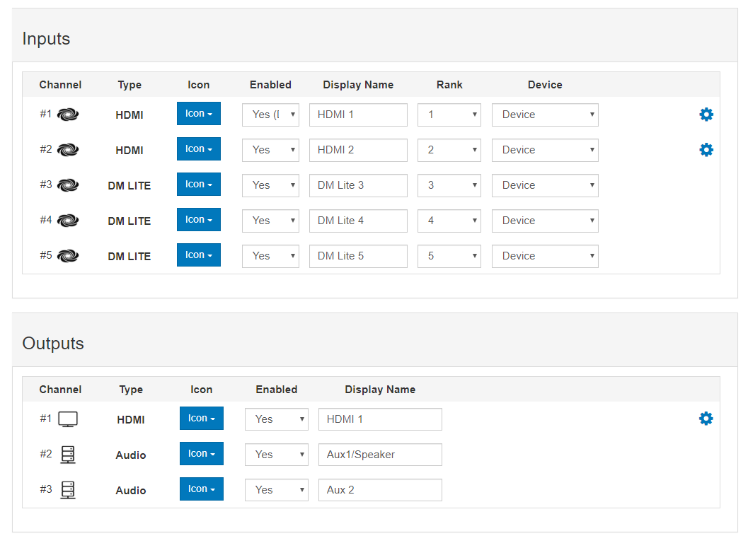
As simple as 1–2–3
Step 2 - Configure
    Configure the A/ V routing
2. Configure A/V Routing

Slide 24
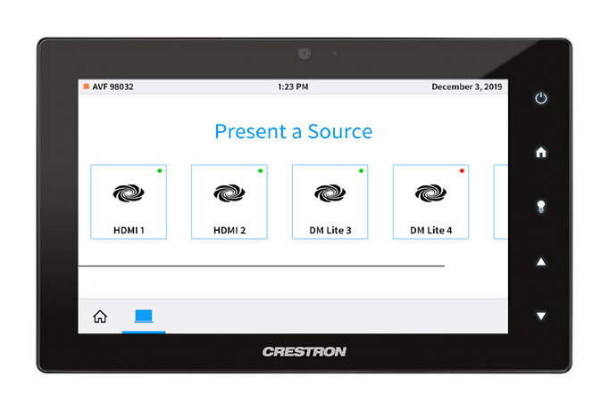
As simple as 1–2–3
Step 3 – Deploy
    You’re ready to go!
    Pick a source and start sharing.
    .AV Framework v6.2
3. Deploy the System

Slide 25
Applications
Vertical markets

Slide 26
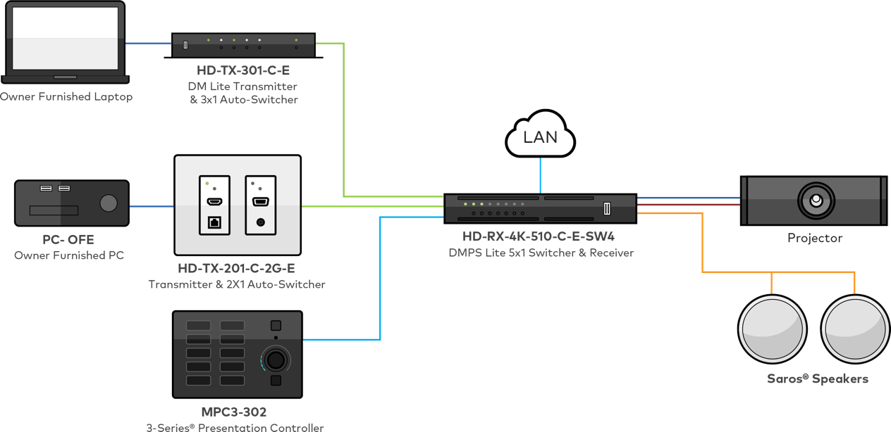

Applications: Education
    Classrooms
    Lounges
    Training rooms
    Common spaces
    Faculty and student meeting rooms

Slide 27

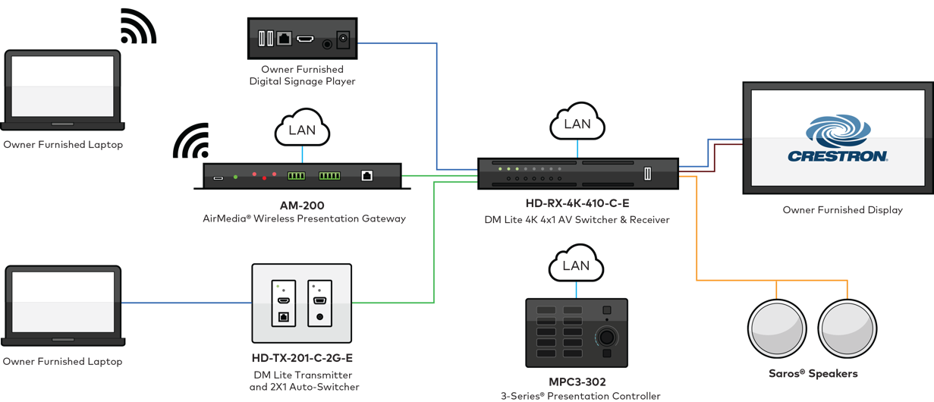
Applications: Enterprise
    Meeting rooms
    Huddle rooms
    Open presentation spaces
    Conference rooms
    Cafeterias

Slide 28
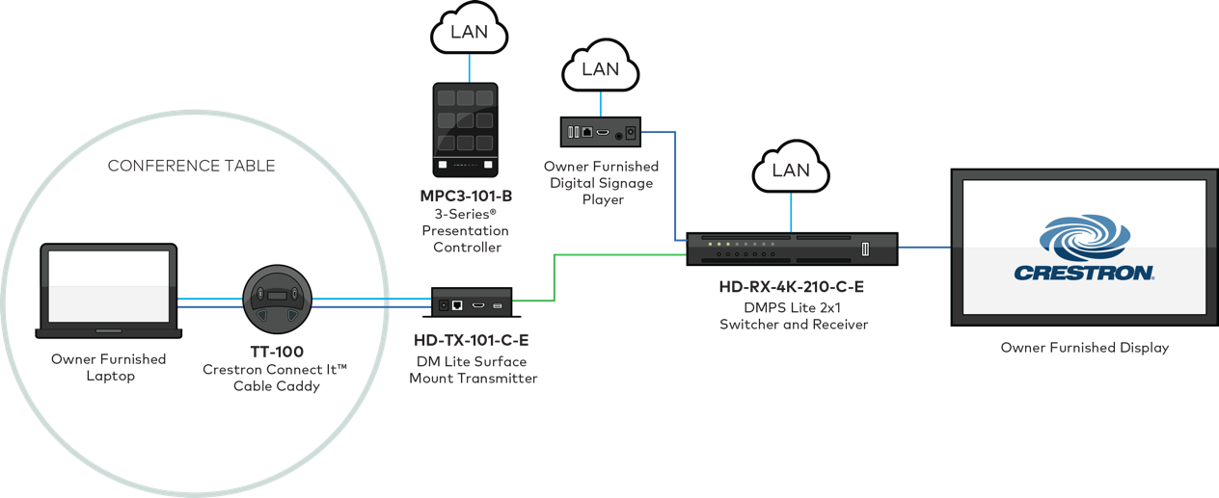

Applications: Government
    Meeting rooms
    Huddle rooms and spaces
    Courtrooms (simple)
    Council rooms
    Small briefing rooms
    Presentation rooms

Slide 29

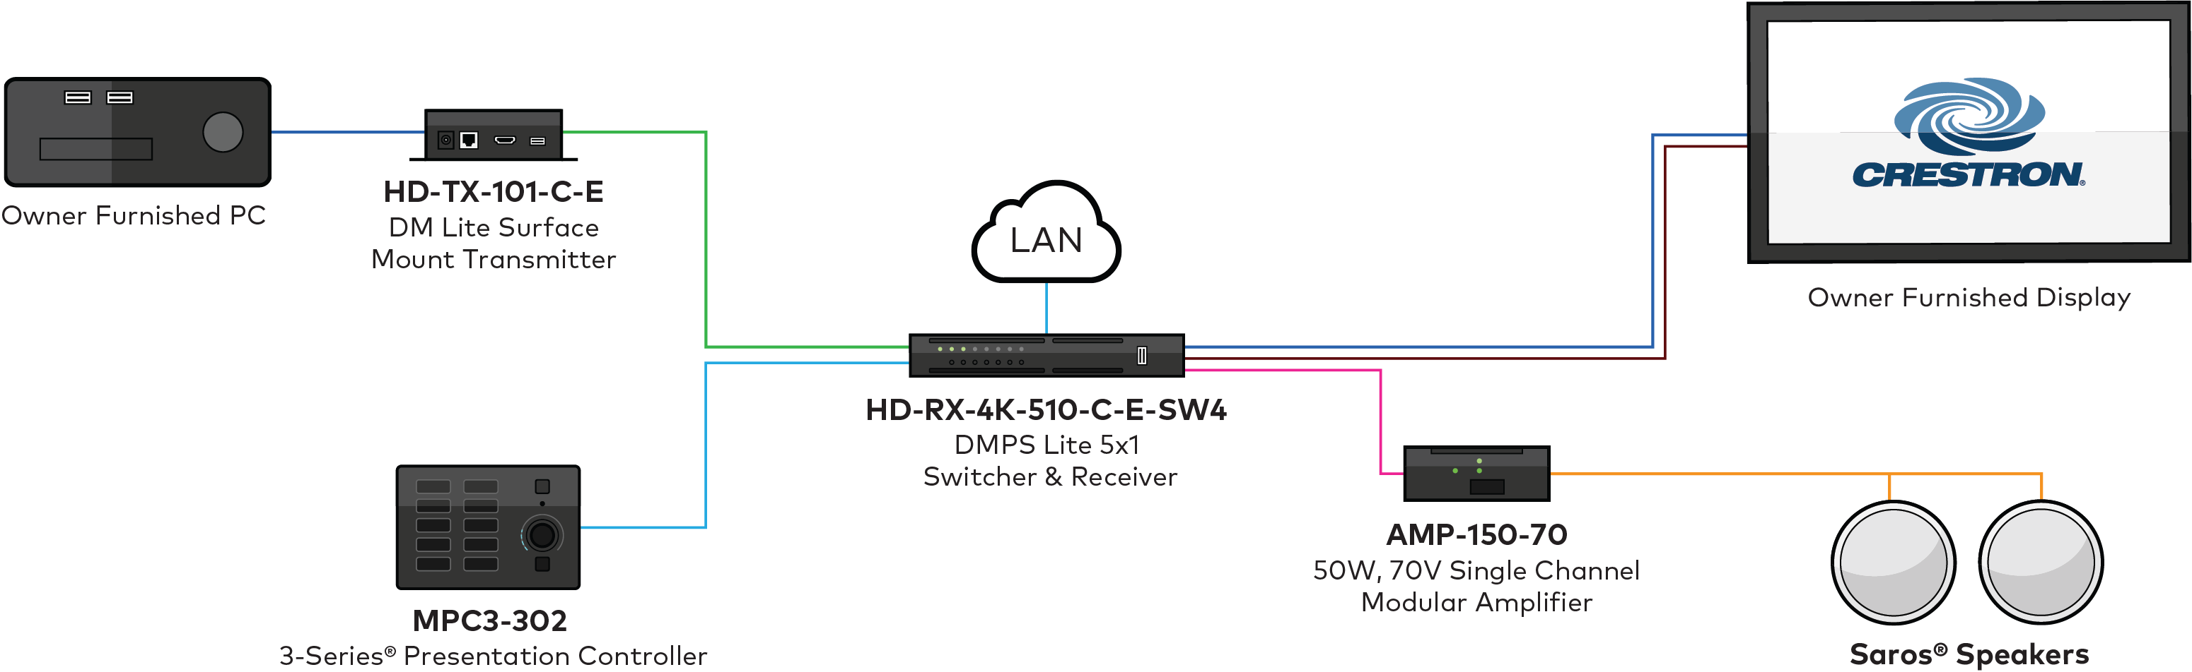
Applications: Retail
    Shop front
    Directories (kiosks)
    Break rooms
    Retail space

Slide 30

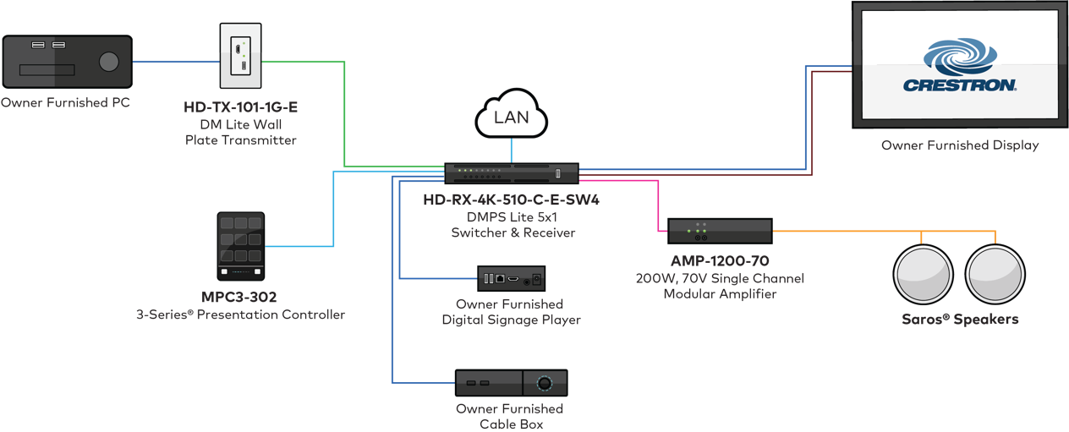
Applications: Hospitality
    Guest rooms
    Lobbies
    Casino gaming rooms
    Briefing rooms in sporting venues

Slide 31
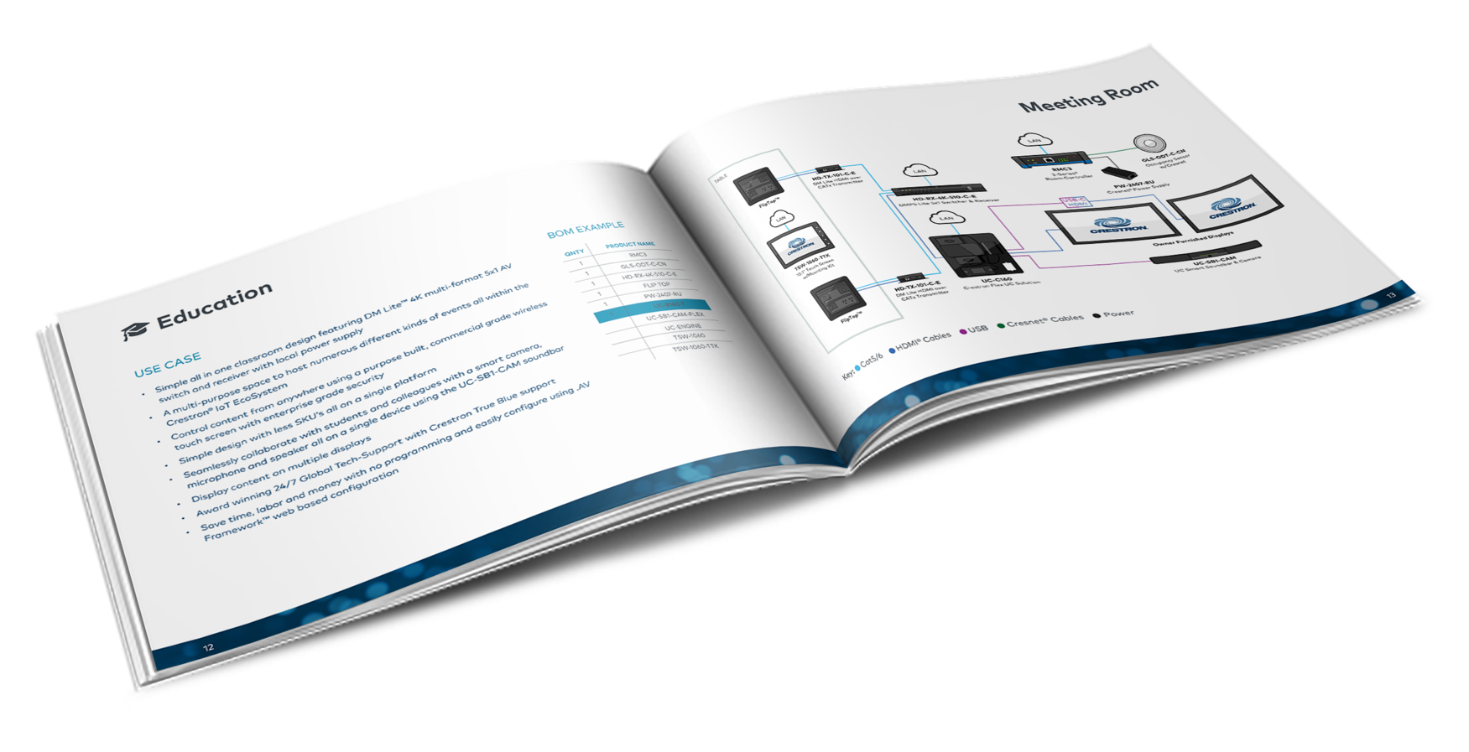
Resources
Visit crestron.com/DMPSLite
    DM Lite and DMPS Lite Design Guide
    DM Lite and DMPS Lite Application Guide

Slide 32
Simple Room Solutions
Q & A

Slide 33
DMPS Lite and DM Lite
Simple Room Solutions
Notes:
https://vimeo.com/368343973

