Slide 1
Crestron HDMI® Switchers
Even the simplest content distribution deserves the best.

Slide 2
Tired of swapping HDMI® cables?
There’s a better way.

Slide 3

Overview
    Easily select and route multiple sources with no programming
    Efficient room solution for the most common content distribution needs, right out of the box
    Supports latest:
      Video formats
      Industry standards
      Security protocols for even the most rigorous InfoSec professionals
      Network-based management

Slide 4

Key features
    4K60 4:4:4 and 18gps
    HDR10+ and Dolby Vision® support
    Integrated display control via CEC without programming or control system
    Auto-routing and priority routing*
    Audio de-embedding
    Enterprise-grade security:
    802.1x, Active Directory® user authentication, PKI Authentication, SSH, HTTPS and TLS
    *on select models

Slide 5

Use cases
    Add HDMI switching capabilities to rooms and systems without programming or disruption
    Simple standalone room solution to route multiple sources to display destinations with CEC control
    Full integration with larger DM® systems, UC applications, and video walls

Slide 6

Use cases
    Build out complete room system or easily upgrade number of connected devices
    Cost effectively expand control, distribution, and collaboration through cross-solution integration, including:
      AirMedia® wireless presentation technology
      Crestron Flex UC Solutions

Slide 7
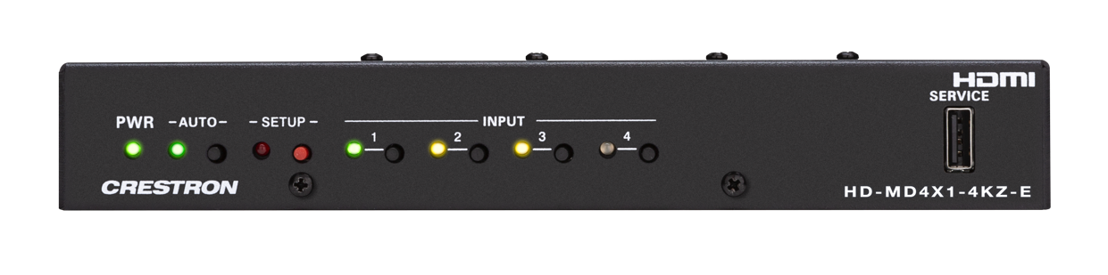
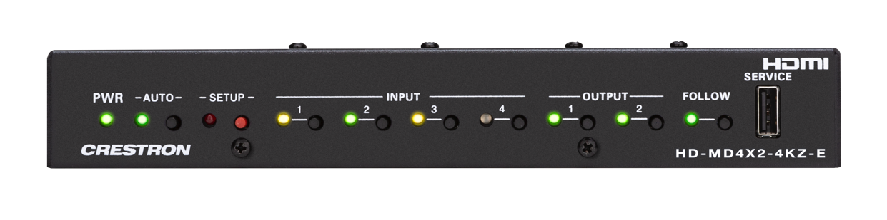
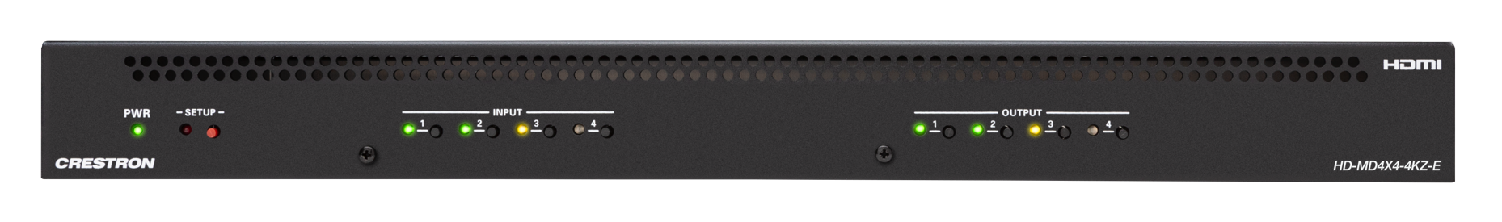
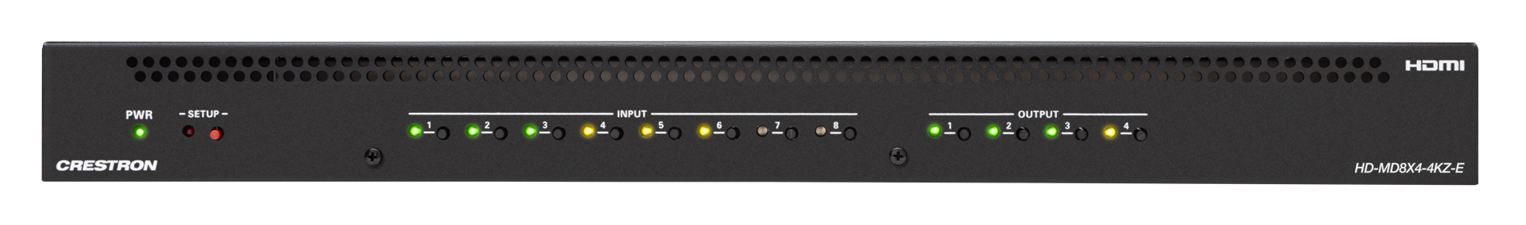
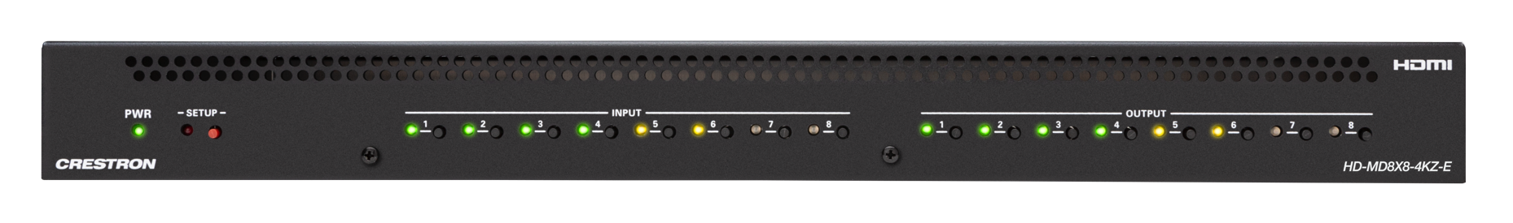
Product family
Model | I/O
HD-MD4X1-4KZ-E | 4X1 HDMI Switcher Auto-route and priority routing
HD-MD4X2-4KZ-E | 4X2 HDMI Switcher Auto-route and priority routing
HD-MD4X4-4KZ-E | 4X4 HDMI Switcher
HD-MD8X4-4KZ-E | 8X4 HDMI Switcher
HD-MD8X8-4KZ-E | 8X8 HDMI Switcher

Slide 8

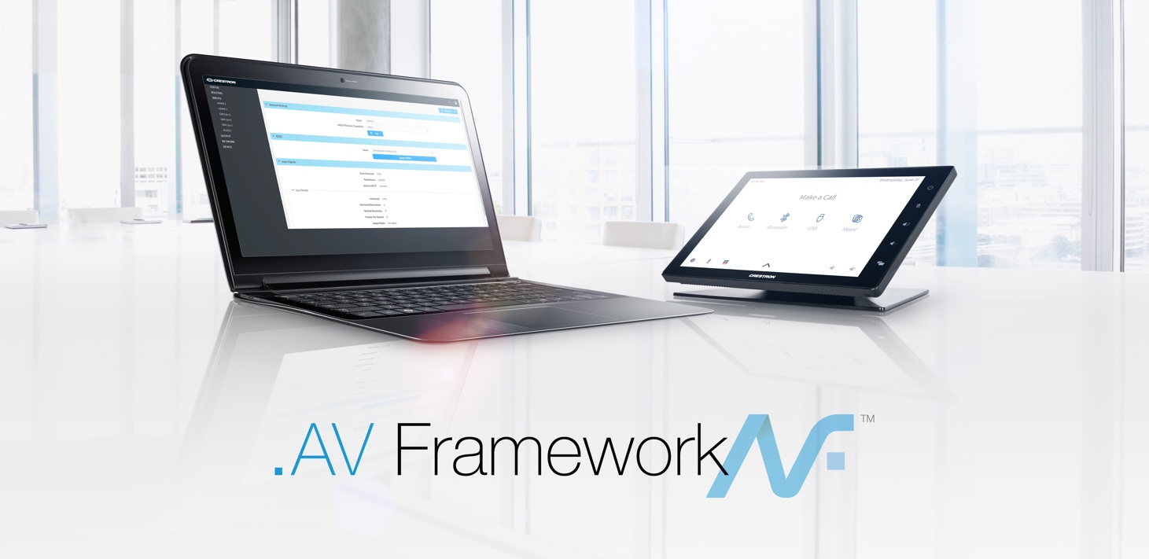

Additional Support
Crestron True Blue Support The best support in the business, 24/7, anywhere in the world. 3-year warranty Legacy of Crestron quality and reliability built into every product. | .AV Framework™ Configure HDMI switchers once, without any programming. Deploy at scale. | Crestron XiO Cloud® The only complete cloud-based deployment and management solution. Configuration Deployment Remote management Help desk integration All at scale

Slide 9
Learn more at crestron.com/DM

